Slide 1
NGS-Happy Project Work Report Start from July 7, 2019

Slide 2
July 7, 2019 Meeting

Slide 3
July 7, 2019 Meeting To-Do
1. Start a PowerPoint summary for each meeting (to do list + record of report) Complete, see July7.2019.ppt
2. Add detailed comments to Unix script Complete, see July7.RealDataDBM.txt
3. Output SNPs only (by adding “-v snps” to only view snps) bcftools view -v snps Complete, see July7.RealDataDBM.txt
4. (1) Convert the DBM input pipe to Perl code. Then compare the two by using “diff”. (2) Prepare DBM input using ≥6 coverage (DP≥6 or AD1+AD2≥6) for 826, 827, 832 on chr10 (3) Output the reference allele and alternative allele
In Progress, see /home/s_m774/project/data/dbm/7.7/prepare.pl

Slide 4
July 14, 2019 Meeting

Slide 5
July 14, 2019 Meeting To-Do
1. Find SNPs for 826 827 832 pair-end data with at least 4X coverage (DP>3)
In Progress, see bwaPairEnd.txt
2. Create and run a Perl script to get the DBM input (compare with the Unix script to make sure you have the same output)
Complete, see /home/s_m774/project/data/dbm/7.14/intersect/prepare.pl
3. (1) Run DBM on a single individual with 4X coverage
(2) Run DBM on 826 827 832 with 4X coverage
Complete, see July14.SingleDBM.txt
Complete, see July14.MultiDBM.txt
4. Prepare the DBM input and then run DBM on SNPs with at least 1X coverage on all individuals
Complete, see July14.IntersectDBM.txt

Slide 6
July 21, 2019 Meeting

Slide 7
July 21, 2019 Meeting To-Do
1. Find SNPs using pair-end data of 826, 827, 832. Then run DBM (chr10).
Complete, see July21.2019.PairEndDBM.txt
2. (1) Run HapSeq2 on sample data
(2) Prepare HapSeq2 input and then run HapSeq2 using real data 826, 827, 832
In progress, see July21.2019.HapSeq2BamParser.txt

Slide 8
July 28, 2019 Meeting

Slide 9
July 28, 2019 Meeting To-Do
Summarize all the work we have done so far
Complete, see slide #6
2. Prepare input on 5 PE individuals, ≥2X coverage, ≥3X samples on each position, and run DBM
Complete, see July28.2019.PairEndDBM
3. (1) Run HapSeq2 on sample data
(2) Prepare input using the 5 PE data, and run HapSeq2
In progress, see July28.2019.HapSeq2

Slide 10
August 13, 2019 Meeting

Slide 11
August 13, 2019 Meeting To-Do
1. (1) Correct the DBM 5 pick 3 task in Unix (2) Create a Perl script to prepare the same input then make sure they give the same results.
Complete, see August13.2019.PairEndDBM
Complete, see /home/s_m774/software/DBM/getStarfish.pl
2. (1) Prepare DBM input showing “ACGT” alleles
Complete, see August13.2019.AllelesDBM
3. Run Hapseq2 on sample data using 4 inputs (jump.txt and read.txt)
Complete, see August13.2019.HapSeq2
4. (1) Prepare Hapseq2 input using 3 samples (2) Run Hapseq2 using real data. First use 2 input files. Next use 4 input files.
In Progress

Slide 12
August 13, 2019 Meeting To-Do
1. (1) Correct the DBM 5 pick 3 task in Unix (2) Create a Perl script to prepare the same input then make sure they give the same results.
Complete, see August13.2019.PairEndDBM
Complete, see /home/s_m774/software/DBM/getStarfish.pl
SS note on Aug 13, 2019: (1) set up the “MinNumSample” (not “depth”) in the argument (so we may change later)
2. Prepare DBM input showing “ACGT” alleles
Complete, see August13.2019.AllelesDBM
SS note on Aug 13, 2019: (1) samples have common chr.pos may have different alternative alleles (choose the one with larger alternative allele count) (2) for quality score, should use the average of more than one sample.
(3) using different names for different output files (not always 8256.pos)
3. Run Hapseq2 on sample data using 4 inputs (jump.txt and read.txt)
Complete, see August13.2019.HapSeq2
4. (1) Prepare Hapseq2 input using 3 samples (2) Run Hapseq2 using real data. First use 2 input files. Next use 4 input files.
In Progress (Continue to do)
New to do:
Check on the DBM and HapSeq2 paper and web page to (1) see if they have available simulation data and real data (2) check on the papers that cite these two papers to see if they have simulation data and real data
Next meeting time: Aug 21 Wed 2:30 pm

Slide 13
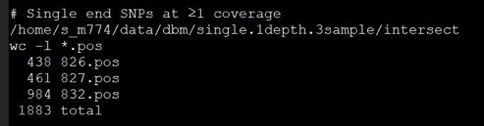
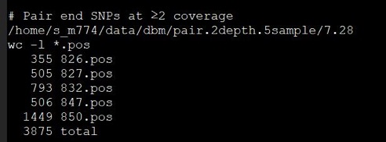
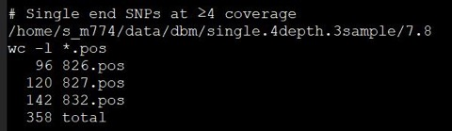
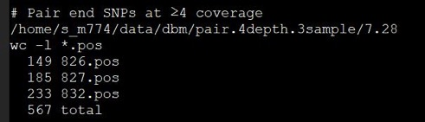
August 13, 2019 Summary
Method | SNP count
Single End (3 samples) | 1714 (Union of 3 samples)
Single End, ≥4 coverage (3 samples) | 246 /home/s_m774/data/dbm/single.4depth.3sample/7.8
Single End, 3 pick 3 (3 samples) | 47 /home/s_m774/data/dbm/single.1depth.3sample/intersect
Pair End, ≥4 coverage (3 samples) | 417 /home/s_m774/data/dbm/pair.4depth.3sample/7.28
Pair End, ≥2 coverage, 5 pick 3 | 120 /home/s_m774/data/dbm/pair.2depth.5sample/8.10 - Starfish

Slide 14
Aug 13, 2019 notes during the meeting for positions with more than 1 alternative alleles.
For position with more than 1 alternative alleles, so far we delete/exclude them (because only 1 or 2 positions for each sample) , see “August13.2019.AllelesDBM.txt”
/home/s_m774/data/dbm/pair.2depth.5sample/allele.8.11
grep ^chr10 826.vcf | cut -f 1,2,4,5,6,10 | sed s/:/\\t/g | awk '{print $1"\t"$2"\t"$9"\t"$3"\t"$4"\t"$5}' | sed s/,/\\t/g | awk 'NF == 7' > 826.pos
grep ^chr10 827.vcf | cut -f 1,2,4,5,6,10 | sed s/:/\\t/g | awk '{print $1"\t"$2"\t"$9"\t"$3"\t"$4"\t"$5}' | sed s/,/\\t/g | awk 'NF == 7' > 827.pos
grep ^chr10 832.vcf | cut -f 1,2,4,5,6,10 | sed s/:/\\t/g | awk '{print $1"\t"$2"\t"$9"\t"$3"\t"$4"\t"$5}' | sed s/,/\\t/g | awk 'NF == 7' > 832.pos
grep ^chr10 826.vcf | cut -f 1,2,4,5,6,10 | sed s/:/\\t/g | awk '{print $1"\t"$2"\t"$9"\t"$3"\t"$4"\t"$5}' | sed s/,/\\t/g | awk 'NF != 7' > 826.multiple
grep ^chr10 827.vcf | cut -f 1,2,4,5,6,10 | sed s/:/\\t/g | awk '{print $1"\t"$2"\t"$9"\t"$3"\t"$4"\t"$5}' | sed s/,/\\t/g | awk 'NF != 7' > 827.multiple
grep ^chr10 832.vcf | cut -f 1,2,4,5,6,10 | sed s/:/\\t/g | awk '{print $1"\t"$2"\t"$9"\t"$3"\t"$4"\t"$5}' | sed s/,/\\t/g | awk 'NF != 7' > 832.multiple
# SNP counts at ≥2 coverage, pair end
wc -l *.pos
354 826.pos
504 827.pos
791 832.pos
wc -l *.multiple
1 826.multiple
1 827.multiple
2 832.multiple
[s_s355@login1 allele.8.11]$ grep 19438631 826.vcf
chr10 19438631 . A G,T 29.769 . DP=3;VDB=0.0221621;SGB=-0.511536;MQ0F=0;AF1=1;AC1=2;DP4=0,0,0,3;MQ=60;FQ=-32.988 GT:PL:DP:AD1/1:72,17,11,60,0,57:3:0,2,1
[s_s355@login1 allele.8.11]$ grep 127016760 827.vcf
chr10 127016760 . T C,A 12.0443 . DP=3;VDB=0.0221621;SGB=-0.511536;MQ0F=0;AF1=1;AC1=2;DP4=0,0,0,3;MQ=29;FQ=-32.9882 GT:PL:DP:AD1/1:53,16,10,42,0,39:3:0,2,1
[s_s355@login1 allele.8.11]$ grep 41879457 832.vcf
chr10 41879457 . C G,A 19.314 . DP=6;VDB=0.0112566;SGB=-0.616816;MQSB=1;MQ0F=0;AF1=1;AC1=2;DP4=0,0,1,5;MQ=20;FQ=-41.9862 GT:PL:DP:AD 1/1:63,26,11,45,0,42:6:0,5,1
[s_s355@login1 allele.8.11]$
[s_s355@login1 allele.8.11]$ grep 133247608 832.vcf
chr10 133247608 . C T,G 34.9733 . DP=4;VDB=0.225386;SGB=-0.556411;MQSB=1;MQ0F=0;AF1=1;AC1=2;DP4=0,0,3,1;MQ=60;FQ=-35.9869 GT:PL:DP:AD1/1:69,11,2,64,0,61:4:0,3,1

Slide 15
August 23, 2019 Meeting

Slide 16
August 23, 2019 Meeting To-Do
1. Set up “MinNumSample” (not “depth”) as an argument in the DBM Perl script (so we may change it later)
Complete, see /home/s_m774/software/DBM/perl/get5SampleKey.pl
2. (1) Choose the larger alternative allele count in samples with the same chr.pos and different alternative alleles (2) Add real quality scores to the DBM input (3) Calculate average quality score of multiple samples
In Progress, see August23.2019.AllelesDBM (To finish)
Complete, see August23.2019.QualityScoreDBM
In Progress, see August23.2019.QualityScoreDBM (To finish)
3. (1) Prepare Hapseq2 real data with 3 samples (2) Run Hapseq2 using real data. First use 2 input files. Next use 4 input files.
In Progress, see August23.2019.HapSeq2RealData (To finish)
4. (1) Check on the DBM and HapSeq2 paper and web page to see if they have available simulation data and real data (2) Check on the papers that cite these two papers to see if they have simulation data and real data.
Complete, see August23.2019.Data
(SS note on Aug 23, 2019 Friday: Check journal web for supple files and software webpage, did not find DBM and HapSeq simultation data, may contact the authors to ask later if necessary)

Slide 17
August 30, 2019 Meeting

Slide 18
August 30, 2019 Meeting To-Do
1. Choose the larger alternative allele count in samples with the same SNP and different alternative alleles
Complete, see August30.2019.AllelesDBM.txt
2. Calculate average quality score of multiple samples
Complete, see August30.2019.QualityScoreDBM.txt (to be revised)
Aug 30, 2019 Friday SS notes: the above code is only for 2 samples. Should revise it for 5 or more samples. Generate two output files, one is the “final” output like the one generated by the above code, another is the middle step output, see below.
Chr pos s1.quality s2.quality s3. quality s4.quality s5.quality
Chr10 127 NA NA 70 61 80
Chr10 350 33 24 NA 12 NA
…
3. (1) Prepare Hapseq2 real data (2) Run Hapseq2 using real data. First use 2 input files. Next use 4 input files. (3) Prepare Hapseq2 real data with 3 samples
In Progress (continue to finish)
4. Check on the papers that cite the DBM and HapSeq2 papers to see if they have simulation data and real data.
In Progress (continue to finish)

Slide 19
September 5, 2019 Meeting

Slide 20
September 5, 2019 Meeting To-Do
1. (1) Get the quality scores of each SNP on each sample (2) Calculate average quality score of 5 samples
Complete, see September5.2019.QualityScoreDBM.txt
2. (1) Prepare Hapseq2 real data (2) Run Hapseq2 using real data. First use 2 input files. Next use 4 input files. (3) Prepare Hapseq2 real data with 3 samples
In Progress, see September5.2019.HapSeq2Input.txt (continued to do)
3. Check on the papers that cite the DBM and HapSeq2 papers to see if they have simulation data and real data.
In Progress
Web links for papers that have the figures listed on the next page:
1. Figure 1: https://biodatamining.biomedcentral.com/articles/10.1186/s13040-019-0198-8
2. Figure 2 https://www.ncbi.nlm.nih.gov/pmc/articles/PMC4530977/

Slide 21
Examples of work flow
Summary of running DBM:
work flow (better to include code, input and output): from raw data to DBM output
1 ~2 paragraph of preparing DBM input and running DBM (words)
Have a code summary (explain what each code really does)
→ this can be part if the work flow. That is 1) and 3) can be combined.
Code summary example: Code.Summary.Aug9.2019.by.Jas.txt under this folder on TRACS
2.Hap.May.2018 Resources/ 6.Files.for.Sherwin

Slide 22
September 12, 2019 Meeting

Slide 23
September 12, 2019 Meeting To-Do
1. (1) Prepare Hapseq2 real data (2) Run Hapseq2 using real data. First use 2 input files. Next use 4 input files. (3) Prepare Hapseq2 real data with 5 samples
In Progress, see September12.2019.HapSeq2Memory
2. (1) Summarize running DBM from raw data to DBM output with a workflow (code, input, and output) (2) Write 1 to 2 paragraphs on preparing DBM input and running DBM (3) Create a code summary explaining what each code does
In Progress, (1) (2)
Complete, see September5.2019.DBMCodes.txt
3. Check on the papers that cite the DBM and HapSeq2 papers to see if they have simulation data and real data.
Complete, see September12.2019.DataSet.txt
Sept 13, 2019 SS Meeting notes:
About Bam And Indexed Bam Files: https://www.biostars.org/p/15847/
Haplotype assembly output of 4 software packages, see the next page (from Bertie’s slide page 18)

Slide 24
# PEATH output, the last hpalotype block (VCF 803-807) is different from HapCUT2, HapCompass, and MixSIH
/home/abj15/Research.Project/Run/PEATH/7.15.2019_826T_chr10.PE
more 826T_chr10_PEATH_haplotype.txt
Block Number: 1 Block Length: 2 Phased Length: 2 Number of R
Block Number: 12 Block Length: 5 Phased Length: 5 Number of Reads: 4 Start position: 803 Weighte
d MEC: 2.01657 MEC: 2
803 0 1
804 0 1
805 1 0
806 1 0
807 1 0
*******
/home/abj15/Research.Project/Run/HapCompass/7.13.2019_826T_chr10.PE
tail 826T_chr10.PE.haplotype.output_MWER_solution.txt
BLOCK 132858318 132858392 158 162 22.0 chr10
VAR_POS_132858318 132858318 158 0 1
VAR_POS_132858336 132858336 159 0 1
VAR_POS_132858370 132858370 160 0 1
VAR_POS_132858380 132858380 161 0 1
VAR_POS_132858392 132858392 162 0 1
/home/abj15/Research.Project/Run/HapCUT2/7.13.2019_826T_chr10.PE
# HapCut2 output: 826T_chr10.PE.haplotype.file
BLOCK: offset: 803 len: 5 phased: 5 SPAN: 74 fragments 4
803 1 0 chr10 132858318 T G 0/1:99,0,12 0. 65.61
804 1 0 chr10 132858336 T C 0/1:50,0,38 0. 65.61
805 1 0 chr10 132858370 C T 0/1:38,0,30 0. 100.00
806 1 0 chr10 132858380 T A 0/1:44,0,16 0. 100.00
1 0 chr10 132858392 G T 0/1:40,0,43
/home/abj15/Research.Project/Run/MixSIH/7.15.2019.826T_chr10.PE
tail 826T_chr10.PE.haplotype.txt
BLOCK: offset: 803 len: 5 phased: 5
803 1 0
804 1 0
805 1 0
806 1 0
807 1 0
********

Slide 25
Software: BWA
Input: FASTA reads
Output: SAM format
Software: Samtools 1.9
Input: SAM format
Output: BAM format
Software: Bcftools 1.9
Input: BAM format
Output: VCF file with SNPs
Software: Get5SampleKey.pl
Input: VCF file with SNPs
Output: sample.snps
Software: GetCounts.pl
Input: SNP file and VCF file
Output: sample.counts
Software: DBM
Input: SNP file and counts file
Output: sample.g

Slide 26
DBM Pipeline
Five samples of pair end fastq reads were alligned to the HG38 human reference genome using BWA. Step 1 is to align the reads using aln (Options -I to specify Illumina 1.3+ and -t to specify thread count were used). Step 2 is to convert the pair end reads to the sam format using sampe (-P to load index to memory for better preformance was used). The mapped reads were converted from sam to bam and sorted using samtools 1.9. Step 1 is to view the reads in bam format using view (-b specified bam output and -o specified the output file). Step 2 is to sort the bam file (-o specified the output file).
The sorted bam file is then searched for SNPs using bcftools 1.9. Step 1 is to use mpileup to find variants (-I Indels are skipped, -g Genotype to BCF output, -a AD annotate Allele Depth, -a DP annotate Depth, -f FASTA format index). Step 2 is to filter the variants for quality using view (-i include only if above minimum depth). Step 3 is to search the vcf file for SNPs using call (-c consensus caller, -v variant sites only output, -o output file.) Next the two DBM input files sample.snps and sample.counts are prepared using the vcf file containing the SNPs. These input files are generated using the perl scripts get5SampleKey.pl and getCount.pl, and the DBM header is inserted into the counts file using the Unix command sed. DBM was ran by specifying the prefix of the two input files sample.snps and sample.counts ('sample' in this case) and the haplotype file sample.g is generated.
D CHR POS I1 I1 I2 I2 I3 I3
0 chr10 48086 0 1 1 0 1 1
1 chr10 789566 1 0 0 1 0 1
2 chr10 1182970 1 1 1 0 0 1
3 chr10 1183069 0 1 0 1 1 1

Slide 27
September 19, 2019 Meeting

Slide 28
September 19, 2019 Meeting To-Do
1. (1) Prepare Hapseq2 input using real data (2) Run Hapseq2 using real data
(3) Prepare Hapseq2 input using 5 samples
In Progress, see September19.2019.HapSeq2BamParser.txt
2. (1) Create a workflow for running DBM from raw data to DBM output
(2) Write 1 to 2 paragraphs on preparing DBM input and running DBM
(1) In Progress (2) Complete, see Slide 16
3. Create a Perl script to format PEATH Haplotype assembly output
Complete, see September19 PerlFormat.txt
4. Create a Perl script to format HapCompass Haplotype assembly output
Complete, see September19 PerlFormat.txt
5. Create a Perl script to format HapCut2 Haplotype assembly output
Complete, see September19 PerlFormat.txt

Slide 29
September 28, 2019 Meeting

Slide 30
September 28, 2019 Meeting To-Do
1. (1) Prepare Hapseq2 input using real data (2) Run Hapseq2 using real data
(3) Prepare Hapseq2 input using 5 samples
In Progress, see September26 2019 HapSeq2RealData.txt
Documented error when running HapSeq2 in the last 5 lines
2. Create a workflow for running DBM from raw data to DBM output
Complete, see Slide 16
3. Update the Perl scripts for PEATH HapCompass Hapcut2 to count Haplotypes
Complete, see September26 2019 PerlFormat.txt

Slide 31
SS note on Sept 28, 2019 Saturday. The error related to the hapseq running error “Person 1 is
Duplicated” (in September26 2019 HapSeq2RealData.txt)
because the first 5 columns (family ID, individual ID, father, mother ID, and gender)
Are not provided correctly because we run part of the bam.parser code sample by sample. See below
We should either manually fix the ”ID” or add “sample ID” as one of the parameters, e.g.,
./bam_parser BAMs/8212ch10.bam chr10wchr.vcf parsed/826chr10 1
# The incorrect one:
> count[1:5, 1:20]
V1 V2 V3 V4 V5 V6 V7 V8 V9 V10 V11 V12 V13 V14 V15 V16 V17 V18 V19 V20
1 1 1 0 0 1 1 1 39 19 0 24 0 42 14 15 0 23 0 138 0
2 1 1 0 0 1 0 0 59 3 26 4 31 6 24 0 0 21 0 118 0
3 1 1 0 0 1 0 2 1 143 20 0 47 25 45 0 0 84 163 201 0
4 1 1 0 0 1 0 0 44 0 21 0 23 0 12 8 0 14 1 157 0
1 1 0 0 1 1 2 52 65 0 25 0 90 20 20 0 57 1 246 111
# The correct one:
> count<-read.table("count.txt", header=F)
> count[1:5, 1:20]
V1 V2 V3 V4 V5 V6 V7 V8 V9 V10 V11 V12 V13 V14 V15 V16 V17 V18 V19 V20
1 1 1 0 0 1 1 1 39 19 0 24 0 42 14 15 0 23 0 138 0
2 2 2 0 0 1 0 0 59 3 26 4 31 6 24 0 0 21 0 118 0
3 3 3 0 0 1 0 2 1 143 20 0 47 25 45 0 0 84 163 201 0
4 4 4 0 0 1 0 0 44 0 21 0 23 0 12 8 0 14 1 157 0
5 5 5 0 0 1 1 2 52 65 0 25 0 90 20 20 0 57 1 246 111

Slide 32
Sept 28, 2019 Saturday meeting notes
ASHG: Oct 15 T - Oct 17 . Math Open House: Nov 8 Friday
Get the poster ready Oct 8 T or Oct 9 Wed:
# Hapseq2 /home/s_m774/data/hapseq2/testrun/sample.haplotype.txt
# DBM: /home/s_m774/data/dbm/pair.2depth.5sample/5sampleDBM.9.28
# These two files are copied to /home/s_m774/data/compare/
HapSeq2
tttggcatgt
cctgacatgc
DBM
ID CHR POS I1 I1
1 chr10 1183608 T T 0 0.5
2 chr10 1185028 T C 1 1
3 chr10 1199953 T A 0 0.5
4 chr10 1233561 T G 0 0.5
5 chr10 1737155 G A 1 1
6 chr10 3010999 C A 0 0.5
7 chr10 3011174 A A 1 1
8 chr10 5073699 T G 0 0.5
9 chr10 5073715 G T 1 0.5
10 chr10 8644132 T C 1 1
"strict" genotype comparison: 5/10 agreement
"not strict" genotype comparision: 7.5/10
output this person by person:
strict compare: 65/120 for sample826 70/120 for sample827 ....
Not strict compare: 80/120 for sample826 95/120 for sample827 ....

Slide 33
October 3, 2019 Meeting

Slide 34
October 3, 2019 Meeting To-Do
1. Create a standard format for genotype data to compare DBM and HapSeq2 genotype data
Complete, see October3 2019 CompareHapSeq2DBM.txt
2. Create code to count the genotype agreement of the DBM and HapSeq2 results using strict pointing
Complete, see /home/s_m774/software/perl/getPoints.pl

Slide 35
October 3, 2019 Meeting To-Do V2
1. Find genotype agreement of the DBM and HapSeq2 results using (1) strict pointing and (2) non-strict pointing
Complete, see October3 2019 Updated Genotype Agreement.txt
# 826
Strict genotype agreement: 49/120
Non-Strict genotype agreement: 83.5/120Job took 0 seconds
# 827
Strict genotype agreement: 48/120
Non-Strict genotype agreement: 81.5/120Job took 0 seconds
# 832Strict genotype agreement: 60/120Non-Strict genotype agreement: 88.5/120Job took 0 seconds# 847Strict genotype agreement: 45/120Non-Strict genotype agreement: 78/120Job took 0 seconds# 850Strict genotype agreement: 62/120Non-Strict genotype agreement: 87.5/120Job took 0 seconds

Slide 36
DBM and HapSeq2 Genotype Comparison
# 826
Strict genotype agreement: 49/120
Non-Strict genotype agreement: 83.5/120
# 827
Strict genotype agreement: 48/120
Non-Strict genotype agreement: 81.5/120
# 832
Strict genotype agreement: 60/120
Non-Strict genotype agreement: 88.5/120
# 847
Strict genotype agreement: 45/120
Non-Strict genotype agreement: 78/120
# 850
Strict genotype agreement: 62/120
Non-Strict genotype agreement: 87.5/120

Slide 37
October 10, 2019 Meeting

Slide 38
October 10, 2019 Meeting To-Do
1. Create code to find haplotype block conflicts in hapcut2 and PEATH haplotype files
Complete, see /home/s_m774/software/perl/getHapcutPeathConflicts.pl
2. (1) Create test cases for the code (2) Run on full hapcut2 and PEATH haplotype file created by Dr. Sun
Complete, see October10 2019 CompareHapCut2PEATH.txt

Slide 39
October 10, 2019 Results
Directory: /home/s_m774/data/compare/peathHapCut
1012/31355 (3.23%): Hapcut and Peath disagree with each other on 1012 out of 31355 Peath blocks.
cut -f 5 fullResult.txt | sort | uniq | wc -l
1012
cut -f 5 hapcutPeath.2019.10.3.txt | sort | uniq | wc -l
31355
4875/115813 (4.21%): HapCut and Peath disagree with each other on 4875 out of the total 115813 SNVs.
Wc –l
4875 fullResult.txt
115813 hapcutPeath.2019.10.3.txt

Slide 40
October 22, 2019 Meeting

Slide 41
October 22, 2019 Meeting To-Do
1. Create a list of more MIHA software packages
In Progress, see October21 2019 MIHA
2. Search for real data with a known truth and simulation data
Complete, Models.zip is provided by GenHap
A. The two files in the root are real data
B. The directories contain simulated input data with their known truth (ground truth) as a txt file with the same name
3. Create a Perl code to compare the 3 SIHA algorithms: Peath, HapCUT2, and mixSIH
In Progress, this task needs refinement

Slide 42
Create a list of more MIHA software packages
(1) check the papers that cited DBM and HapSeq2 to see which software DBM and HapSeq2 have been compared with
(2) based on the excels from Bertie
(3) Just simply Google

Slide 43
Create code to compare the 3 SIHA algorithms: Peath, HapCUT2, and mixSIH
1. Which blocks have all 3 agree, 2 agree, and 0 agree
Note: I can output the agreement of software packages being either
A. 3 way
B. Disagreement exists
2. Select one input’s block ID to output the 12 columns of the input file
+ # of HA agreement 3, 2, or 0
+ two haplotypes preferred 000, 111, with the reference allele "0" on the left

Slide 44
November 7, 2019 Meeting

Slide 45
November 7, 2019 Meeting To-Do
1. Create a Perl code to compare the 3 SIHA algorithms: Peath, HapCUT2, and mixSIH
Complete, see getAgreement12Col Peath HapCut2 MixSIH 2019.11.7
2. Check these papers for MIHA software packages:
HAPI-UR, 2012
MaCH, 2010
BEAGLE, 2007
In Progress

Slide 46
November 21, 2019 Meeting

Slide 47
November 21, 2019 Meeting To-Do
1. Fix comparing three SIHA algorithms by adding the last block (last block is not reported)
Complete, see comparingSIHA 2019.11.20
2. Sort the data first by hapcut/Mix SIH blk ID, they should give the same results as the one shown on page 12 of the ASHG poster
Complete, see comparingSIHA 2019.11.20
3. Add a 3rd column that print out which 2 software packages agree "PeathHapcut" or "HapcutPeath"
Complete, see comparingSIHA 2019.11.20
4. Run the Whatshap algorithm (1) for just 1 sample (example script attached) and (2) for multiple samples in collaboration with Bertie (she will provide her script to you)
In Progress, see WhatsHap install 2019 Nov28 conda

Slide 48
November 30, 2019 Meeting

Slide 49
November 30, 2019 Meeting
1. (1) Comparing 3 SIHA algorithms: add "-" for 0 agreement of 3 HA algorithms; (2) add column 4, which is the number of SNVs in each block (3) consider how to extend it to compare 4 or more HA algorithms
(1) Complete compareSIHA 2019 Nov 30
(2) Complete
2. (1) Install Whatshap and (2) run for single sample and (3) multiple-samples
In Progress
3. Provide a detailed summary of running DBM and Hapseq2, one text file for each of these software packages
Complete, DBM workflow 2019 Nov 30
Complete, Hapseq2 workflow 2019 Nov 30

Slide 50
December 12, 2019 Meeting

Slide 51
December 12, 2019 Meeting
1. Create a Perl script for pairwise comparison conduct pairwise comparison for any two HA algorithms
Complete, script generated results matching our poster data
2. Conduct pairwise comparison of HA algorithms against Whatshap results
In progress, Dr. Sun and my pairwise comparison results conflict
3. Conduct 3-way comparison for any three algorithms (testing on Whatshap as it is different from the others)
4. Conduct 4-way comparison for any four algorithms

Slide 52
December 20, 2019 Meeting

Slide 53
1. Correct Perl script for pairwise comparisons with unique variants
Complete
2. Conduct pairwise comparison of HA algorithms against Whatshap results
Complete, Dr. Sun and my own Whatshap results conflict
3. Create a 3-way comparison script, Create a 4-way comparison script
In progress

Slide 54
December 27, 2019 Meeting

Slide 55
1. Fix the 2-way comparison results, do not print the extra "last +1" block, compare with Dr. Sun's 5-column output files /home/s_s355/research3/NGS.hap.run/Oct3.2019.check.HA/Dec22.2019*
Complete, diff results conflict only at positions where hapcut and mix have no haplotype, see pairwise compare 2019 Dec 25
2. Create 3-way comparison code
Complete, results matched with chart results when using fake data, see 3 way compare 2019 Dec 25
3. Check the 3-way comparison code
(1) print out the top 20 and then 40 SNV to get results manuallly
(2) use fake HA output (e.g, peath, wshap, peath)
Complete, see 3 way compare 2019 Dec 25
4. Install and run HapCHAT
In progress, Installing dependencies using email instructions by Shane

Slide 56
Jan 3, 2020 Meeting

Slide 57
1. Add guiding messages for the users in the 2HA comparison “the order of the input files will affect the output results.” “The 5 columns in the 1st output are:”
Complete, I added guiding messages to the 2 way comaparison
2. Generate a matrix/table as a 2nd output file "The 2nd output is printed below and it is saved in file"
Complete, I updated the output to be formatted as a matrix and output it to a file
3. Install and run HapCHAT
Complete, HapCHAT ran example data provided by HapCHAT
Results are here: HapCHAT.2020.Jan.1
4. Update the 3-way comparison code to generate similar output as the 2 HA algorithm. Show both the manual checking and counting results and the perl results on a 100 SNV sample
In progress, I will update the code to be functionally similar to our 2 way comparison code

Slide 58
Jan 10, 2020 Meeting

Slide 59
1. Run a 2-way comparison after removing the "-" from HapCUT2 and MixSIH2, and create a new table using Jan3.2020.pairwise.compare.4HA.xlsx.
Complete, see slide 60-62
2. Run HapCHAT on sample data, and a smaller version of the VCF file
Complete, HapCHAT ran on the first 100 lines of NA sample
See slide 63
3. (1) Install Whatshap (2) Run for single sample and (3) multiple-sample
An instruction file on installing conda is posted on TRACS (Nov21.2019.Install.Conda.docx)
In progress, Installing Whatshap

Slide 60
1. Run a 2-way comparison after removing the "-" from HapCUT2 and MixSIH2, and create a new table using Jan3.2020.pairwise.compare.4HA.xlsx.
[s_m774@login2 2WaySIHA2020.1.1]$ pwd
/home/s_m774/Haplotype-Research/2WaySIHA2020.1.1
[s_m774@login2 2WaySIHA2020.1.1]$ perl ../compare2HA.pl peath.4col.txt hapcut.4col.txt 1 results/peathHapcut
[s_m774@login2 2WaySIHA2020.1.1]$ perl ../compare2HA.pl peath.4col.txt mixSIH.4col.txt 1 results/peathMix
[s_m774@login2 2WaySIHA2020.1.1]$ perl ../compare2HA.pl peath.4col.txt whatshap.4col.txt 1 results/peathWhatshap
[s_m774@login2 2WaySIHA2020.1.1]$ perl ../compare2HA.pl hapcut.4col.txt peath.4col.txt 1 results/hapcutPeath
[s_m774@login2 2WaySIHA2020.1.1]$ perl ../compare2HA.pl hapcut.4col.txt mixSIH.4col.txt 1 results/hapcutMix
[s_m774@login2 2WaySIHA2020.1.1]$ perl ../compare2HA.pl hapcut.4col.txt whatshap.4col.txt 1 results/hapcutWhatshap

Slide 61
[s_m774@login2 2WaySIHA2020.1.1]$ perl ../compare2HA.pl mixSIH.4col.txt peath.4col.txt 1 results/mixPeath
[s_m774@login2 2WaySIHA2020.1.1]$ perl ../compare2HA.pl mixSIH.4col.txt hapcut.4col.txt 1 results/mixHapcut
[s_m774@login2 2WaySIHA2020.1.1]$ perl ../compare2HA.pl mixSIH.4col.txt whatshap.4col.txt 1 results/mixWhatshap
[s_m774@login2 2WaySIHA2020.1.1]$ perl ../compare2HA.pl whatshap.4col.txt peath.4col.txt 1 results/whatshapPeath
[s_m774@login2 2WaySIHA2020.1.1]$ perl ../compare2HA.pl whatshap.4col.txt hapcut.4col.txt 1 results/whatshapHapcut
[s_m774@login2 2WaySIHA2020.1.1]$ perl ../compare2HA.pl whatshap.4col.txt mixSIH.4col.txt 1 results/whatshapMix

Slide 62
# Created a new table using Jan3.2020.pairwise.compare.4HA.xlsx
# Our Hapcut Key results conflict, The rest of the packages agree on both Block and SNV
# Hapcut and Peath results verified manually (First 80 SNV)
[s_m774@login2 2WaySIHA2020.1.1]$ perl ../compare2HA.pl hapcut.4col.txt peath.4col.txt 1 results/hapcutPeath
Output colums: Block ID, HA1 count, HA2 count, Variant agreement, Haplotype agreement
The order of the input files will affect the output results
Using input 1 block ID as key
The 2nd output is printed below and saved in file
Key agree disag total agree% disagree%
Block 31963 289 32252 0.991039315391294 0.00896068460870644
SNV 108937 6280 115217 0.945494154508449 0.0545058454915507
Possible next step: investigate which blocks conflict between results

Slide 63
#################################
# HapCHAT not running on sample data: whatHap not found
# http://hapchat.algolab.eu/
#################################
# Setup the enviorenment
source activate mypython352
module load gcc/7.2.0
module list
(mypython352) [s_m774@login2 HapCHAT-master]$ pwd
/home/s_m774/HapCHAT_build/HapCHAT-master

Slide 64
Jan 17, 2020 Meeting

Slide 65
3. (1) Install Whatshap (2) Run for single sample and (3) multiple-sample
Complete, Installed via Conda
Complete, Ran WhatsHap on single sample. WhatsHap needs .bam .bai .vcf files to phase.
In progress, Ran WhatsHap on multi sample in this pipeline: Align reads > index bam files > call SNPs > merge .vcf from multi sample to a single .vcf using bcftools merge > Phase haplotype using Whatshap
Output has 0 phased haplotypes

Slide 66
# Created bam index files
[s_m774@login1 whatshap.data]$ pwd
/home/s_m774/data/whatshap.data
[s_m774@login1 whatshap.data]$ /group/hon/hon3398o/0.course.files/software/samtools-1.9/samtools index 826.sorted.bam 826.sorted.bai
[s_m774@login1 whatshap.data]$ /group/hon/hon3398o/0.course.files/software/samtools-1.9/samtools index 827.sorted.bam 827.sorted.bai
[s_m774@login1 whatshap.data]$ ls
826.sorted.bai 826.sorted.bam 826.vcf 827.sorted.bai 827.sorted.bam 827.vcf

Slide 67
# Prepare merged vcf
# step 1: zip vcf
[s_m774@login1 whatshap.data]$ /group/hon/hon3398o/0.course.files/software/bcftools-1.9/bcftools view -l 1 -o 826.vcf.gz
826.vcf
[s_m774@login1 whatshap.data]$ /group/hon/hon3398o/0.course.files/software/bcftools-1.9/bcftools view -l 1 -o 827.vcf.gz
827.vcf
# step 2: index vcf
[s_m774@login1 whatshap.data]$ /group/hon/hon3398o/0.course.files/software/bcftools-1.9/bcftools index 826.vcf.gz
[s_m774@login1 whatshap.data]$ /group/hon/hon3398o/0.course.files/software/bcftools-1.9/bcftools index 827.vcf.gz
[s_m774@login1 whatshap.data]$ ls
826.sorted.bai 826.vcf 826.vcf.gz.csi 827.sorted.bam 827.vcf.gz
826.sorted.bam 826.vcf.gz 827.sorted.bai 827.vcf 827.vcf.gz.csi
# step 3: merge vcf
[s_m774@login1 whatshap.data]$ /group/hon/hon3398o/0.course.files/software/bcftools-1.9/bcftools merge -o 826.827.vcf 826.vcf.gz 827.vcf.gz
# step 4: phase with whatshap
[s_m774@login1 whatshap.data]$ whatshap phase -o results/phased.826.827.vcf 826.827.vcf 826.sorted.bam 827.sorted.bam

Slide 68
[s_m774@login1 whatshap.data]$ tail results/phased.826.827.vcf
chrUn_KI270516v1 142 . C T 11.1139 . DP=2;VDB=0.02;SGB=-0.453602;MQ0F=0.0;AF1=1.0;AC1=2.0;MQ=23;FQ=-32.9882;DP4=0,0,0,2 GT:PL:DP:AD ./.:.:.:. 1/1:42,6,0:2:0,2
chrUn_KI270516v1 146 . C T 11.1139 . DP=2;VDB=0.02;SGB=-0.453602;MQ0F=0.0;AF1=1.0;AC1=2.0;MQ=23;FQ=-32.9882;DP4=0,0,0,2 GT:PL:DP:AD ./.:.:.:. 1/1:42,6,0:2:0,2
chrUn_KI270519v1 50638 . A G 79.5134 . DP=4;VDB=0.0058656;SGB=-0.556411;MQ0F=0.0;AF1=1.0;AC1=2.0;MQ=37;FQ=-38.9864;DP4=0,0,4,0 GT:PL:DP:AD ./.:.:.:. 1/1:112,12,0:4:0,4
chrUn_KI270744v1 109178 . C T 28.7701 . DP=2;VDB=0.02;SGB=-0.453602;MQ0F=0.0;AF1=1.0;AC1=2.0;MQ=33;FQ=-32.988;DP4=0,0,2,0 GT:PL:DP:AD ./.:.:.:. 1/1:60,6,0:2:0,2
chrUn_KI270744v1 109188 . G T 19.0264 . DP=3;VDB=0.991985;MQSB=1.0;SGB=-0.511536;MQ0F=0.0;AF1=1.0;AC1=2.0;MQ=32;FQ=-35.9869;DP4=0,0,2,1 GT:PL:DP:AD ./.:.:.:. 1/1:51,9,0:3:0,3
chrUn_KI270744v1 109322 . A G 29.1197 . DP=3;VDB=0.02;RPB=1.0;MQB=1.0;BQB=1.0;MQSB=1.0;SGB=-0.453602;MQ0F=0.0;AF1=0.512851;AC1=1.0;MQ=33;FQ=-14.1557;PV4=0.333333,1.0,1.0,0.0;DP4=1,0,0,2 GT:PL:DP:AD ./.:.:.:. 0/1:59,0,13:3:1,2
chrUn_KI270754v1 36070 . C A 21.7931 . DP=2;VDB=0.02;SGB=-0.453602;MQ0F=0.0;AF1=1.0;AC1=2.0;MQ=29;FQ=-32.988;DP4=0,0,2,0 GT:PL:DP:AD ./.:.:.:. 1/1:53,6,0:2:0,2
chrUn_KI270757v1 16096 . A C 12.0443 . DP=2;VDB=0.02;SGB=-0.453602;MQ0F=0.0;AF1=1.0;AC1=2.0;MQ=24;FQ=-32.9882;DP4=0,0,2,0 GT:PL:DP:AD ./.:.:.:. 1/1:43,6,0:2:0,2
chrUn_KI270757v1 16203 . G A 4.60864 . DP=2;VDB=0.02;SGB=-0.453602;MQ0F=0.0;AF1=1.0;AC1=2.0;MQ=24;FQ=-32.9897;DP4=0,0,0,2 GT:PL:DP:AD ./.:.:.:. 1/1:34,6,0:2:0,2
chrUn_KI270757v1 16221 . G T 12.0443 . DP=2;VDB=0.02;SGB=-0.453602;MQ0F=0.0;AF1=1.0;AC1=2.0;MQ=24;FQ=-32.9882;DP4=0,0,0,2 GT:PL:DP:AD ./.:.:.:. 1/1:43,6,0:2:0,2

Slide 69
Jan 24, 2020 Meeting

Slide 70
1. Create input for Whatshap multisample: see Bertie’s work report notes on PPT slide 88 - 98
I added a sample identifier to each RG and prepared a single VCF using bcftools mpileup. Haplotype phased with WhatsHap, See slide 71
2. (1) Run Whatshap with indels included for each single sample (826, 827, 832, 847, 850)
(2) and 5 sample
(3) See WhatsHap_5_samples.Nov24.2019.txt for Bertie's script and screen output and use diff to compare your two's output
(4) Diff the phased.vcf of each sample with the phased.vcf from the 5-sample
see Bertie's PPT slide 94 -98 for her previous comparison
3. (1) Filter out the indels for each sample
(2) Phase each sample without indels (3) phase 5 sample
(3) Diff the phased.vcf of each sample with the phased.vcf from the 5-sample
4. Check the default coverage setting for Whatshap and see if we can change this setting
5. Check if Whatshap supports phasing for homozygous sites "1/1"
see the following example from the end of "WhatsHap_826T_827T.Nov23.2019.txt"

Slide 71
[s_m774@login2 MIHA.input.2020.1.14]$ pwd
/home/s_m774/data/MIHA.input.2020.1.14
# tagged each bam file with read group
[s_m774@login2 whatshap.data]$ /group/hon/hon3398o/0.course.files/software/samtools-1.9/samtools addreplacerg -r 'ID:826' -r 'SM:826' -o 826RG.chr10.bam 826.chr10.sorted.bam
[s_m774@login2 whatshap.data]$ /group/hon/hon3398o/0.course.files/software/samtools-1.9/samtools addreplacerg -r 'ID:826' -r 'SM:827' -o 827RG.chr10.bam 827.chr10.sorted.bam
# index each bam
[s_m774@login1 whatshap.data]$ /group/hon/hon3398o/0.course.files/software/samtools-1.9/samtools index 826RG.chr10.bam 826RG.chr10.bai
[s_m774@login1 whatshap.data]$ /group/hon/hon3398o/0.course.files/software/samtools-1.9/samtools index 827RG.chr10.bam 827RG.chr10.bai
# bamList.txt
826RG.chr10.bam
827RG.chr10.bam

Slide 72
# call SNPs with mpileup
# -b bam list
# -f FASTA format index
# filter SNPs with bcftools call
# -c consensus caller
# -v variant sites only output
# -o output file
[s_m774@login2 whatshap.data]$ /group/hon/hon3398o/0.course.files/software/bcftools-1.9/bcftools mpileup -b bamList.txt -f chr10.fa | /group/hon/hon3398o/0.course.files/software/bcftools-1.9/bcftools call -cv -o 826.827.chr10.vcf

Slide 73
# compress and index VCF
# -l level of compression
# -o output
[s_m774@login1 whatshap.data]$ /group/hon/hon3398o/0.course.files/software/bcftools-1.9/bcftools view -l 1 -o 826.827.chr10.vcf.gz 826.827.chr10.vcf
[s_m774@login1 whatshap.data]$ /group/hon/hon3398o/0.course.files/software/bcftools-1.9/bcftools index 826.827.chr10.vcf.gz
# Phase with Whatshap
[s_m774@login1 whatshap.data]$ whatshap phase -o results/phased.826.827.vcf 826.827.chr10.vcf 826RG.chr10.bam 827RG.chr10.bam
This is WhatsHap 0.18 running under Python 3.7.4
Working on 2 samples from 2 families

Slide 74
[s_m774@login1 whatshap.data]$ tail results/phased.826.827.vcf
chr10 133441924 . G A 30.0189 . DP=1;SGB=-0.157211;MQ0F=0.0;AF1=1.0;AC1=4.0;MQ=60;FQ=-27.3623;DP4=0,0,1,0 GT:PL 1/1:60,3,0 0/1:0,0,0
chr10 133442100 . G A 225.109 . DP=5;VDB=0.534935;SGB=-0.950356;MQ0F=0.0;AF1=1.0;AC1=4.0;MQ=60;FQ=-35.6405;DP4=0,0,5,0 GT:PL 1/1:110,6,0 1/1:150,9,0
chr10 133454558 . A C 11.3455 . DP=1;SGB=-0.157211;MQ0F=0.0;AF1=1.0;AC1=4.0;MQ=60;FQ=-27.3625;DP4=0,0,1,0 GT:PL 0/1:0,0,0 1/1:41,3,0
chr10 133454581 . T A 30.0189 . DP=1;SGB=-0.157211;MQ0F=0.0;AF1=1.0;AC1=4.0;MQ=60;FQ=-27.3623;DP4=0,0,1,0 GT:PL 0/1:0,0,0 1/1:60,3,0
chr10 133454677 . A G 19.0686 . DP=1;SGB=-0.157211;MQ0F=0.0;AF1=1.0;AC1=4.0;MQ=60;FQ=-27.3624;DP4=0,0,0,1 GT:PL 0/1:0,0,0 1/1:49,3,0
chr10 133497304 . G T 10.4272 . DP=1;SGB=-0.157211;MQ0F=0.0;AF1=1.0;AC1=4.0;MQ=40;FQ=-27.3626;DP4=0,0,1,0 GT:PL 1/1:40,3,0 0/1:0,0,0
chr10 133525528 . T C 5.46268 . DP=5;RPB=1.0;MQB=1.0;BQB=1.0;SGB=-0.516033;MQ0F=0.0;AF1=0.499907;AC1=2.0;MQ=60;FQ=7.80603;PV4=1.0,1.8677e-05,1.0,1.0;DP4=4,0,1,0 GT:PL 0/0:0,0,0 0/1:34,0,171
chr10 133566184 . C T 88.7677 . DP=2;VDB=0.68;MQSB=1.0;SGB=0.0985265;MQ0F=0.0;AF1=1.0;AC1=4.0;MQ=60;FQ=-28.7411;DP4=0,0,1,1 GT:PL 1/1:120,6,0 1/1:0,0,0
chr10 133566206 . A C 84.7676 . DP=2;VDB=0.68;MQSB=1.0;SGB=0.0985265;MQ0F=0.0;AF1=1.0;AC1=4.0;MQ=60;FQ=-28.7411;DP4=0,0,1,1 GT:PL 1/1:116,6,0 1/1:0,0,0
chr10 133659386 . A T 7.79817 . DP=4;RPB=1.0;MQB=1.0;BQB=1.0;SGB=-0.516033;MQ0F=0.0;AF1=0.499956;AC1=2.0;MQ=43;FQ=10.431;PV4=1.0,0.0303153,1.0,1.0;DP4=3,0,1,0 GT:PL 0/1:37,0,89 0/1:0,0,0

Slide 75
Jan 31, 2020 Meeting

Slide 76
1. (1) Run Whatshap for 5 samples with indels included
(2) and a single sample
(3) See WhatsHap_5_samples.Nov24.2019.txt for Bertie's script and screen output and compare your two's output
Phased results conflict: Sherwin phased more blocks in each sample with WhatsHAP - See slide 77
(4) Diff the phased.vcf of single sample with the phased.vcf from the 5-sample
see Bertie's PPT slide 94 -98 for her previous comparison
WhatsHAP includes a ‘.’ in phasing multi samples, otherwise results are identical - See slide 79
2. (1) Filter out the indels for each sample
(2) Phase single sample without indels (3) phase 5 sample
(4) Diff the phased.vcf of each sample with the phased.vcf from the 5-sample
3. Check the default coverage setting for Whatshap and see if we can change this setting
https://whatshap.readthedocs.io/en/latest/guide.html#features-and-limitations
Default coverage is 15X – WhatHAP does not seem have this setting based in their documentation
4. Check if Whatshap supports phasing for homozygous sites "1/1"
see the following example from the end of "WhatsHap_826T_827T.Nov23.2019.txt“
See slide 80

Slide 77
# Sherwin WhatsHAP output
---- Processing individual 826
MEC cost: 5340
No. of phased blocks: 149
Largest component contains 11 variants (2.8% of accessible variants) between position 43119791 and 43119827
---- Processing individual 827
MEC cost: 6605
No. of phased blocks: 194
Largest component contains 8 variants (1.5% of accessible variants) between position 43119801 and 43119827
---- Processing individual 832
MEC cost: 6526
No. of phased blocks: 326
Largest component contains 14 variants (1.5% of accessible variants) between position 43119407 and 43119916
---- Processing individual 847
MEC cost: 8249
No. of phased blocks: 153
Largest component contains 12 variants (2.7% of accessible variants) between position 43119646 and 43119827
---- Processing individual 850
MEC cost: 8588
No. of phased blocks: 460
Largest component contains 15 variants (1.2% of accessible variants) between position 41877847 and 41878157

Slide 78
# Bertie WhatsHAP output
---- Processing individual 826T
[W::hts_idx_load2] The index file is older than the data file: data/826T_chr10_PE_rg.bam.sorted.bai
MEC cost: 5732
No. of phased blocks: 120
Largest component contains 10 variants (3.0% of accessible variants) between position 43119791 and 43119827
---- Processing individual 827T
MEC cost: 7040
No. of phased blocks: 179
Largest component contains 7 variants (1.4% of accessible variants) between position 133128749 and 133128801
---- Processing individual 832T
MEC cost: 7208
No. of phased blocks: 279
Largest component contains 14 variants (1.7% of accessible variants) between position 43119437 and 43119916
---- Processing individual 847T
MEC cost: 8089
No. of phased blocks: 149
Largest component contains 10 variants (2.3% of accessible variants) between position 43119646 and 43119827
---- Processing individual 850T
MEC cost: 8559
No. of phased blocks: 411
Largest component contains 11 variants (0.9% of accessible variants) between position 41877865 and 41878157

Slide 79
[s_m774@login1 compare.2020.1.31]$ diff phased.826.singleSample.vcf phased.5sample.singleSample.vcf | wc -l
8186
diff phased.5sample.singleSample.vcf phased.826.singleSample.vcf | cut -f 1,2,4,5,9,10 | less
< chr10 47754 T C GT:PL:PS 0/0:0,21,110:.
< chr10 47771 C T GT:PL:PS 0/0:0,15,152:.
< chr10 47774 A C GT:PL:PS 0/0:0,15,152:.
---
> chr10 47754 T C GT:PL 0/0:0,21,110
> chr10 47771 C T GT:PL 0/0:0,15,152
> chr10 47774 A C GT:PL 0/0:0,15,152
503,504c503,504
< chr10 76557 G T GT:PL:PS 0/1:0,0,0:.
< chr10 76560 G T GT:PL:PS 0/1:0,0,0:.
---
> chr10 76557 G T GT:PL 0/1:0,0,0
> chr10 76560 G T GT:PL 0/1:0,0,0
[s_m774@login1 compare.2020.1.31]$ diff phased.5sample.singleSample.vcf phased.826.singleSample.vcf | grep '|' | wc -l
0

Slide 80
# Homozygous sites in Sherwin 5 sample result
grep '1/1' phased.5sample.vcf | cut -f 1,2,10-14 | less
chr10 814408 0/1:0,0,0 0/1:0,0,0 0/1:0,0,0 0/1:0,0,0 1/1:110,6,0
chr10 848090 0/1:0,0,0:. 0/1:0,0,0:. 0|1:0,0,0:848090 0/1:0,0,0:. 1/1:43,3,0:.
chr10 848099 0/1:0,0,0:. 0/1:0,0,0:. 0|1:0,0,0:848090 0/1:0,0,0:. 1/1:43,3,0:.
chr10 860048 0/1:0,0,0 0/1:0,0,0 0/1:0,0,0 0/1:0,0,0 1/1:45,3,0
WhatsHAP paper:
https://www.biorxiv.org/content/10.1101/085050v2.full.pdf
“Analogous conclusions can be drawn in other cases and in larger pedigrees as long as the variant is homozygous in at least one individual.”

Slide 81
Meeting Notes:
1. Slides 77 and 78 shows that Sherwin called more blocks than Bertie did. These differences may be due to the following reasons
(1) Sherwin called the SNV using 5 samples together, but Bertie called samples and then merged the results.
(2) Sherwin used the samtools to add "RG", but Bertie used picards.
SS note: I think the first note (1) will be the reason why they different number of block.
2. About changing coverage level, the following web says :WhatsHap is an exact, fixed-parameter tractable (FPT) algorithm for the wMEC
problem, with read coverage as the only fixed parameter." In the screen output, it says "---- Processing individual 826
Using maximum coverage per sample of 15X", then we may have to get into the original code to change the coverage.
https://www.biorxiv.org/content/10.1101/085050v2.full.pdf

Slide 82
Feb 6, 2020 Meeting

Slide 83
1. (1) Compare the first 3 columns (chr, pos, ref-allele) of phased.826.singleSample.vcf phased.5sample.singleSample.vcf
(2) compare the 4th column (alt-allele)
(3) Use the sed command sed 's/:.//g’ for the 5-sample column 10 to see if they are exactly the same
Same haplotype results
See Slide 84
2. (1) Filter out the indels from the VCF file
(2) Phase single sample without indels
(3) phase 5 sample
(4) Diff the phased.vcf of single sample with the phased.vcf from the 5-sample
Same haplotype results
See Slide 86

Slide 84
[s_m774@login2 compare]$ pwd
/home/s_m774/data/whatshap.data/results/compare
[s_m774@login2 results]$ cut -f 1,2,3,4,10 phased.826.ch10.vcf > compare.2020.2.2/826.5col.txt
[s_m774@login2 results]$ cut -f 1,2,3,4,10 phased.5sample.vcf | sed s/:.//g > compare.2020.2.2/5sample.5col.txt
[s_m774@login2 compare.2020.2.2]$ diff 5sample.5col.txt 826.5col.txt | less
< chr10 46025 . C 0/1,0,0
< chr10 46026 . C 0/1,0,0
< chr10 47663 . C 1/1,0,0
< chr10 47754 . T 0/0,21,110
< chr10 47771 . C 0/0,15,152
< chr10 47774 . A 0/0,15,152

Slide 85
# no difference on first 4 columns. difference must be in haplotypes.
[s_m774@login2 results]$ cut -f 1,2,3,4 826.5col.txt > 826.first4col.txt
[s_m774@login2 results]$ cut -f 1,2,3,4 5sample.5col.txt > 5sample.first4col.txt
[s_m774@login2 compare.2020.2.2]$ diff 5sample.first4col.txt 826.first4col.txt
< ##bcftools_callCommand=call -cv -o 5sample.chr10.vcf; Date=Fri Jan 31 1192 2020
< ##commandline="(whatshap 0.18) phase -o results/phased.5sample.vcf 5sample.chr10.vcf 826RG.chr10.bam 827RG.chr10.bam 832RG.chr10.bam 847RG.chr10.bam 850RG.chr10.bam"
---
> ##bcftools_callCommand=call -cv -o 5sample.chr10.vcf; Date=Fri Jan 31 11:39:52 2020
> ##commandline="(whatshap 0.18) phase -o results/phased.826.ch10.vcf 5sample.chr10.vcf 826RG.chr10.bam"

Slide 86
[s_m774@login2 whatshap.data]$ /group/hon/hon3398o/0.course.files/software/bcftools-1.9/bcftools view --types snps -o noIndels.5sample.chr10.vcf 5sample.chr10.vcf
[s_m774@login2 whatshap.data]$ whatshap phase -o results.february1/phased.5sample.vcf noIndels.5sample.chr10.vcf 826RG.chr10.bam 827RG.chr10.bam 832RG.chr10.bam 847RG.chr10.bam 850RG.chr10.bam
[s_m774@login2 whatshap.data]$ whatshap phase -o results.february1/phased.826.chr10.vcf noIndels.5sample.chr10.vcf 826RG.chr10.bam
[s_m774@login2 results.february1]$ cut -f 1,2,3,4,10 phased.826.chr10.vcf > compare.2020.2.2/826.5col.txt
[s_m774@login2 results.february1]$ cut -f 1,2,3,4,10 phased.5sample.vcf | sed s/:.//g > compare.2020.2.2/5sample.5col.txt
[s_m774@login2 compare.2020.2.2]$ diff 5sample.5col.txt 826.5col.txt | less
< chr10 46025 . C 0/1,0,0
< chr10 46026 . C 0/1,0,0
< chr10 47663 . C 1/1,0,0
< chr10 47754 . T 0/0,21,110

Slide 87
Feb 14, 2020 Meeting @ 1PM

Slide 88
Feb 21, 2020 Meeting @ 1PM

Slide 89
1. (1) Compare DBM, HapSeq2, WhatsHAP 5-sample results by phasing the WhatsHAP dataset: Phase the same SNV positions with DBM and HapSeq2
I am preparing the DBM and HapSeq2 input format now
(2) then compare haplotypes sample by sample as we did in the ASHG
2. Check support of non sequential block IDs in perl program per Bertie:
“HapCUT2 produces HA output with consecutive SNVs in non-consecutive blocks I have created two files, one sorted by SNVs and another sorted by block id.
Please do a pairwise comparison using PEATH as it is well ordered by SNV and its blocks are consecutive. ”
The Perl code will need to be updated to add support for non-sequential Block-ID -- I am working on this.

Slide 90
DBM workflow:
Call SNPs with bcftools mpileup adding the “–a AD” option to count each allele
Create an input file that is a list of the position of each SNP
Create input file that is a count of alleles at each position
Phase with DBM

Slide 91
Feb 21, 2020 Meeting @ 1PM

Slide 92
1. (1) Add support for when block ID are not CONSECUTIVE (e.g., 1, 2, 4, 5, with "3" missing) to the perl code of pair-wise comparison
(2) Use hapcut's blk as reference sorted by SNV and by blk ID separately to show the results are the same
(3) Use Peath as the reference blocks with Hapcut sorted by SNV and by blk ID as input to show the results are the same
compare2HA.pl supports not consecutive and unsorted blocks, See slide 93
2. (1) Extract the 120 SNV positions used in DBM and HapSeq2
(2) then output Whatshap phased haplotypes of those 120 SNVs
(3) Compare DBM, HapSeq2, and whatshap
I located the 120 positions used in DBM and Hapseq. I am working on getting the intersect with Whatshap

Slide 93
[s_m774@login2 2WaySIHA2020.2.20]$ pwd
/home/s_m774/Haplotype-Research/2WaySIHA2020.2.20
# Hapcut as a key
[s_m774@login2 2WaySIHA2020.2.20]$ perl ../compare2HA.pl hapcut2.sortbySNV.Feb10.2020.txt peath.4col.txt results/snvSortedHapcutPeath
Haplotype agreement is printed below and saved to file
Key agree disag total agree% disagree%
Block 31964 188 32152 0.994152774321971 0.00584722567802936
SNV 109063 6150 115213 0.946620607049552 0.0533793929504483
[s_m774@login2 2WaySIHA2020.2.20]$ perl ../compare2HA.pl hapcut2.sortbyblk.Feb10.2020.txt peath.4col.txt results/blockSortedHapcutPeath
Haplotype agreement is printed below and saved to file
Key agree disag total agree% disagree%
Block 31964 188 32152 0.994152774321971 0.00584722567802936
SNV 109063 6150 115213 0.946620607049552 0.0533793929504483
[s_m774@login2 results]$ diff blockSortedHapcutPeath.blocks.txt snvSortedHapcutPeath.blocks.txt

Slide 94
# Peath as a key
[s_m774@login2 2WaySIHA2020.2.20]$ perl ../compare2HA.pl peath.4col.txt hapcut2.sortbyblk.Feb10.2020.txt results/peathHapcutBlocks
Haplotype agreement is printed below and saved to file
Key agree disag total agree% disagree%
Block 30342 1013 31355 0.967692553021847 0.0323074469781534
SNV 102828 12985 115813 0.887879599008747 0.112120400991253
[s_m774@login2 2WaySIHA2020.2.20]$ perl ../compare2HA.pl peath.4col.txt hapcut2.sortbySNV.Feb10.2020.txt results/peathHapcutSNV
Haplotype agreement is printed below and saved to file
Key agree disag total agree% disagree%
Block 30342 1013 31355 0.967692553021847 0.0323074469781534
SNV 102828 12985 115813 0.887879599008747 0.112120400991253
[s_m774@login2 results]$ diff peathHapcutBlocks.blocks.txt peathHapcutSNV.blocks.txt

Slide 95
Feb 28, 2020 Meeting @ 1PM

Slide 96
1. (1) Extract the intersect of 120 SNV positions used in DBM and HapSeq2 from Whatshap blocks
(2) Convert Whatshap’s haplotype results to allele format
(3) Locate the HapSeq2 and DBM 120 alleles used in poster and paste each to a single file with 120 rows 8 col
Chrom pos HA1 HA1 HA2 HA2 HA3 HA3
(4) Get pairwise agreement of DBM, HapSeq2, and whatshap using Perl script getPoints.pl
Whatshap’s results converted to DBM format to compare—Whatshap has a very low phase rate in these 120 positions. I am now locating the DBM and HapSeq2 results. See slide 97
2. Look into renumbering haplotype blocks in compare2HA.pl
Perl script now renumbers blocks from 1 to n--no longer keeping the original block IDs. See slide 98
3. Create a Perl script for 3 way agreement and compare the 3 packages

Slide 97
/home/s_m774/data/120.comparison/allele.whatshap
perl getAlleles.pl happy826.whatshap.txt allele826.whatshap.txt
# 20/120 SNV phased by Whatshap in sample 850
sort allele850.whatshap.txt | uniq -c
100 - -
1 A C
4 A G
1 C A
3 C T
1 G A
3 G C
2 G T
1 T A
4 T C

Slide 98
Q: Why do we want to renumber blocks when existing blocks already match between Bertie and Sherwin?
# Renumbered Block ID of last 100k Hapcut positions
tail -n 100000 data/SIHA/hapcut2.sortbySNV.Feb10.2020.txt > Haplotype-Research/2WaySIHA2020.feb.27/last.100k.hapcut.txt
perl ../compare2HA.pl last.100k.hapcut.txt peath.4col.txt results/snvSortedHapcutPeath
Block CountA CountB SNVs Haplotype
1 40 40 match -
2 2 2 match match
3 2 2 match match
4 4 4 match match
5 5 5 match match

Slide 99
/home/s_m774/Haplotype-Research/2WaySIHA2020.feb.27
# Bertie's input file location
/home/abj15/Research.Project/Run/Comparisons/pair-wise/7.Feb10.2020
File names:
hapcut2.sortbySNV.Feb10.2020.txt | sorted by SNV
hapcut2.sortbyblk.Feb10.2020.txt | sorted by block id
perl ../compare2HA.pl hapcut2.sortbySNV.Feb10.2020.txt peath.4col.txt results/snvSortedHapcutPeath
Haplotype agreement is printed below and saved to file
Key agree disag total agree% disagree%
Block 31964 188 32152 0.994152774321971 0.00584722567802936
SNV 109063 6150 115213 0.946620607049552 0.0533793929504483

Slide 100
Mar 6, 2020 Meeting @ 1PM

Slide 101
1. (1) Paste alleles into a single file for a sample--120 rows 10 columns
Ex: Chrm Pos Ref Alt HA1 HA1 HA2 HA2 HA3 HA3
(2) Get pairwise agreement of DBM, HapSeq2, and whatshap using Perl script getPoints.pl
(3) Create charts for pairwise results of DBM-Whatshap and HapSeq-Whatshap
Packages assemble side by side for manual count
Pairwise charts of genotypes completed for all 3 packages, see slide 103
2. (1) Phase DBM using Whatshap dataset
(2) Phase Hapseq2 using Whatshap dataset
I am working with the SNPs used in Whathap to prepare DBMs 2 inputs

Slide 102
/home/s_m774/data/compare/MIHA.2020.2.28/eyeball.3packages
# 3 packages assembled side by side in order to eyeball
paste chrm.120pos.txt ref.alt.120pos.txt > 4col.txt
paste 4col.txt 826dbmGenotype.txt > 6col.txt
paste 6col.txt 826hapseq2Genotype.txt > 8col.txt
paste 8col.txt allele826.whatshap.txt > dbm.hapseq2.whatshap.826.10col.txt
chr10 1183608 C T T T T C - -
chr10 1185028 C T T C T C C T
chr10 1199953 A T T A T T T T
chr10 1233561 T G T G G G G G
chr10 1737155 G A G A G A G A
chr10 3010999 A C C A C C C C
chr10 3011174 C A A A A A A A
chr10 5073699 G T T G T T T T
chr10 5073715 T G G T G G G G

Slide 103
Unphased alleles as conflict (-)
DBM and WhatsHAP Pairwise Comparison
Agreement | 826 | 827 | 832 | 847 | 850
Strict | 36 | 37 | 43 | 35 | 47
Non-strict | 64.5 | 67.5 | 69.5 | 62 | 70.5
HapSeq2 and WhatsHAP Pairwise Comparison
Agreement | 826 | 827 | 832 | 847 | 850
Strict | 89 | 96 | 97 | 91 | 95
Non-strict | 92 | 99.5 | 97.5 | 93.5 | 98

Slide 104
Mar 12, 2020 Meeting @ 1PM

Slide 105
1. (1) Update getAlleles perl code to output all alleles even unphased
(2) Get genotype pairwise results of DBM-Whatshap and HapSeq-Whatshap and update table
(3) Get alleles on samples 826,827,832,847,850 from each package
(4) For each of 5 samples paste alleles into a single file - 120 rows
Chrm Pos Ref Alt DBM HapSeq Whtshp Whtshp-Haplotype
(5) Get Whatshap block ID from Whatshap results
Pairwise tables updated with Genotype agreement
See slide 107 for side by side alleles
2.Use R to get haplotype agreements for pairwise comparisons in DBM, Whatshap, HapSeq2
Pairwise tables updated with Haplotype agreement
1 conflict with poster is bolded on the DBM-Hapseq table
3. (1) Phase DBM using Whatshap dataset
(2) Phase Hapseq2 using Whatshap dataset

Slide 106
Genotypes include unphased alleles (no -)
DBM and WhatsHAP Pairwise Comparison
Agreement | 826 | 827 | 832 | 847 | 850
Strict | 50 | 48 | 60 | 46 | 60
Non-strict | 83.5 | 81 | 88.5 | 79 | 86
haplotype | 59.5 | 63.5 | 61.5 | 58 | 65.5
HapSeq2 and WhatsHAP Pairwise Comparison
Agreement | 826 | 827 | 832 | 847 | 850
Strict | 109 | 110 | 116 | 110 | 113
Non-strict | 114.5 | 114.5 | 118 | 115 | 116.5
haplotype | 87 | 94.5 | 87.5 | 89.5 | 90
ASHG: HapSeq2 and DBM Pairwise Comparison
Agreement | 826 | 827 | 832 | 847 | 850
Strict | 49 | 48 | 60 | 45 | 62
Non-strict | 83.5 | 81.5 | 88.5 | 78 | 87.5
haplotype | 76.5 | 71.5 | 75.5 | 70 | 76.5

Slide 107
Pasted 3 packages into a single file to eyeball agreements:
/home/s_m774/data/dbmWhatshap.pairwise.mar8.2020/R
Key
CHR POS REF ALT DBM DBM2 HAP HAP2 WHP WHP2 WHP-Haplotype WHP-Haplotype2
chr10 1183608 C T T T T C C T - -
chr10 1185028 C T T C T C C T C T
chr10 1199953 A T T A T T T T T T
chr10 1233561 T G T G G G G G G G
chr10 1737155 G A G A G A G A G A
chr10 3010999 A C C A C C C C C C
chr10 3011174 C A A A A A A A A A
chr10 5073699 G T T G T T T T T T

Slide 108
Mar 20, 2020 Meeting @ 11AM

Slide 109
1. Phase Hapseq2 using Whatshap dataset
Whatshap dataset was phased using Hapseq2
/home/s_m774/data/miha/
/home/s_m774/software/HapSeq2/hapseq2 --readCounts counts.chr10.txt --polymorphicSites sites.chr10.txt -o phased.chr10.hapseq.txt --phase
2. Phase DBM using Whatshap dataset
I have created 1 of the 2 required inputs for DBM. I am now getting the Allele Depth for each SNV—most modern phasing software packages do this by looking BAMs (Whatshap and Hapseq for example).

Slide 110
Mar 27, 2020 Meeting @ 11AM

Slide 111
1. Phase DBM using Whatshap dataset
I phased the same dataset using DBM—DBM seems to use reference alleles in the case of missing reads. Haplotype result is located here:
/home/s_m774/data/miha/dbm.2020.mar20/chr10.5sample.g
2. Get a list of positions on chromosome 10 phased by Whatshap
I extracted a list of these positions located at
/home/s_m774/data/miha/whatshap.2020.Mar27
3. Pairwise comparison of Whatshap and Hapseq2 without filtering
4. Get the depth of each of the Whatshap 13557 positions
I extracted the depth of each of these positions at
/home/s_m774/data/miha/whatshap.2020.Mar27

Slide 112
April 3, 2020 Meeting @ 11AM

Slide 113
1. (1) Filter DBM Haplotypes on positions phased by Whatshap
(2) Filter Hapseq2 Haplotypes on positions phased by Whatshap
(3) Convert Whatshap Haplotypes to alleles using VCF
(4) Pairwise comparison of haplotypes for each MIHA package
(5) Pairwise comparison of genotypes for each MIHA package
I extracted the genotypes here:
/home/s_m774/data/miha/compare.2020.Apr3/individuals/
Preliminary genotype comparison results on slides 114 – 117
I am using R to compare the haplotypes of dbm, hapseq, whatshap.
2. (1) Get Whatshap phased positions with a coverage >= 20
(2) Pairwise comparison with coverage >= 20
List of positions with high coverage located here:
/home/s_m774/data/miha/whatshap.2020.Mar27/20depth.positions.whatshap.txt

Slide 114
DBM vs Hapseq2
[s_m774@login2 haplotypes]perl /home/s_m774/Haplotype-Research/getPoints.pl dbm.genotype.826.chr10.txt hapseq2.genotype.826.chr10.txt
Strict genotype agreement: 5752/12442
Non-Strict genotype agreement: 7714.5/12442
[s_m774@login2 haplotypes]$ perl /home/s_m774/Haplotype-Research/getPoints.pl dbm.genotype.827.chr10.txt hapseq2.genotype.827.chr10.txt pseq2.genotype.850.chr10.txt
Strict genotype agreement: 5737/12442
Non-Strict genotype agreement: 7767.5/12442
[s_m774@login2 haplotypes]$ perl /home/s_m774/Haplotype-Research/getPoints.pl dbm.genotype.832.chr10.txt hapseq2.genotype.832.chr10.txt
Strict genotype agreement: 5937/12442
Non-Strict genotype agreement: 7967/12442
[s_m774@login2 haplotypes]$ perl /home/s_m774/Haplotype-Research/getPoints.pl dbm.genotype.847.chr10.txt hapseq2.genotype.847.chr10.txt
Strict genotype agreement: 5701/12442
Non-Strict genotype agreement: 7792.5/12442
[s_m774@login2 haplotypes]$ perl /home/s_m774/Haplotype-Research/getPoints.pl dbm.genotype.850.chr10.txt hapseq2.genotype.850.chr10.txt
Strict genotype agreement: 5802/12442
Non-Strict genotype agreement: 8046.5/12442

Slide 115
DBM vs Whatshap
[s_m774@login2 haplotypes]$ perl /home/s_m774/Haplotype-Research/getPoints.pl dbm.genotype.826.chr10.txt whatshap.haplotype.826.chr10.txt
Strict genotype agreement: 2185/12442
Non-Strict genotype agreement: 2600/12442
[s_m774@login2 haplotypes]$ perl /home/s_m774/Haplotype-Research/getPoints.pl dbm.genotype.827.chr10.txt whatshap.haplotype.827.chr10.txt
Strict genotype agreement: 2091/12442
Non-Strict genotype agreement: 2609.5/12442
[s_m774@login2 haplotypes]$ perl /home/s_m774/Haplotype-Research/getPoints.pl dbm.genotype.832.chr10.txt whatshap.haplotype.832.chr10.txt
Strict genotype agreement: 2770/12442
Non-Strict genotype agreement: 3554.5/12442
[s_m774@login2 haplotypes]$ perl /home/s_m774/Haplotype-Research/getPoints.pl dbm.genotype.847.chr10.txt whatshap.haplotype.847.chr10.txt
Strict genotype agreement: 1925/12442
Non-Strict genotype agreement: 2368/12442
[s_m774@login2 haplotypes]$ perl /home/s_m774/Haplotype-Research/getPoints.pl dbm.genotype.850.chr10.txt whatshap.haplotype.850.chr10.txt
Strict genotype agreement: 3325/12442
Non-Strict genotype agreement: 4439.5/12442

Slide 116
Hapseq2 vs Whatshap
[s_m774@login2 haplotypes]$ perl /home/s_m774/Haplotype-Research/getPoints.pl hapseq2.genotype.826.chr10.txt whatshap.haplotype.826.chr10.txt
Strict genotype agreement: 3451/12442
Non-Strict genotype agreement: 4095.5/12442
[s_m774@login2 haplotypes]$ perl /home/s_m774/Haplotype-Research/getPoints.pl hapseq2.genotype.827.chr10.txt whatshap.haplotype.827.chr10.txt
Strict genotype agreement: 3555/12442
Non-Strict genotype agreement: 4174/12442
[s_m774@login2 haplotypes]$ perl /home/s_m774/Haplotype-Research/getPoints.pl hapseq2.genotype.832.chr10.txt whatshap.haplotype.832.chr10.txt
Strict genotype agreement: 4820/12442
Non-Strict genotype agreement: 5439/12442
[s_m774@login2 haplotypes]$ perl /home/s_m774/Haplotype-Research/getPoints.pl hapseq2.genotype.847.chr10.txt whatshap.haplotype.847.chr10.txt
Strict genotype agreement: 3120/12442
Non-Strict genotype agreement: 3741/12442
[s_m774@login2 haplotypes]$ perl /home/s_m774/Haplotype-Research/getPoints.pl hapseq2.genotype.850.chr10.txt whatshap.haplotype.850.chr10.txt
Strict genotype agreement: 6048/12442
Non-Strict genotype agreement: 6598/12442

Slide 117
April 10, 2020 Meeting @ 11AM

Slide 118
1. (1) Filter DBM haplotypes on Whatshap high coverage positions
(2) Filter Hapseq2 haplotypes on Whatshap high coverage positions
(3) Pairwise comparison of MIHA with coverage >= 20
Preliminary results of pairwise comparison on genotypes on slides 119 - 121

Slide 119
DBM vs Whatshap
[s_m774@login1 individuals.20depth.apr10.2020]$ perl /home/s_m774/Haplotype-Research/getPoints.pl dbm.genotype.826.chr10.txt genotype.20depth.whatshap.chr10.826.txt
Strict genotype agreement: 246/628
Non-Strict genotype agreement: 354.5/628
[s_m774@login1 individuals.20depth.apr10.2020]$ perl /home/s_m774/Haplotype-Research/getPoints.pl dbm.genotype.827.chr10.txt genoype.20depth.whatshap.chr10.827.txt
Strict genotype agreement: 270/628
Non-Strict genotype agreement: 374/628
[s_m774@login1 individuals.20depth.apr10.2020]$ perl /home/s_m774/Haplotype-Research/getPoints.pl dbm.genotype.832.chr10.txt genotype.20depth.whatshap.chr10.832.txt
Strict genotype agreement: 282/628
Non-Strict genotype agreement: 382.5/628
[s_m774@login1 individuals.20depth.apr10.2020]$ perl /home/s_m774/Haplotype-Research/getPoints.pl dbm.genotype.847.chr10.type.20depth.whatshap.chr10.847.txt
Strict genotype agreement: 272/628
Non-Strict genotype agreement: 374/628
[s_m774@login1 individuals.20depth.apr10.2020]$ perl /home/s_m774/Haplotype-Research/getPoints.pl dbm.genotype.850.chr10.ype.20depth.whatshap.chr10.850.txt
Strict genotype agreement: 287/628
Non-Strict genotype agreement: 379.5/628

Slide 120
Whatshap vs hapseq2
[s_m774@login1 individuals.20depth.apr10.2020]$ perl /home/s_m774/Haplotype-Research/getPoints.pl hapseq2.genotype.826.chr10.txt genotype.20depth.whatshap.chr10.826.txt
perl /home/s_m774/HStrict genotype agreement: 560/628
Non-Strict genotype agreement: 594/628
[s_m774@login1 individuals.20depth.apr10.2020]$ perl /home/s_m774/Haplotype-Research/getPoints.pl hapseq2.genotype.827.chr10.txtenotype.20depth.whatshap.chr10.827.txt
perl /home/s_m774/Haplotype-Research/getPoints.pl hStrict genotype agreement: 575/628
Non-Strict genotype agreement: 601.5/628
[s_m774@login1 individuals.20depth.apr10.2020]$ perl /home/s_m774/Haplotype-Research/getPoints.pl hapseq2.genotype.832.chr10.txt genotype.20depth.whatshap.chr10.832.txt
Strict genotype agreement: 577/628
Non-Strict genotype agreement: 602/628
[s_m774@login1 individuals.20depth.apr10.2020]$ perl /home/s_m774/Haplotype-Research/getPoints.pl hapseq2.genotype.847.chr10.enotype.20depth.whatshap.chr10.847.txt
Strict genotype agreement: 572/628
Non-Strict genotype agreement: 599/628
[s_m774@login1 individuals.20depth.apr10.2020]$ perl /home/s_m774/Haplotype-Research/getPoints.pl hapseq2.genotype.850.chr10.txtenotype.20depth.whatshap.chr10.850.txt
Strict genotype agreement: 572/628
Non-Strict genotype agreement: 600/628

Slide 121
DBM vs hapseq2
[s_m774@login1 individuals.20depth.apr10.2020]$ perl /home/s_m774/Haplotype-Research/getPoints.pl dbm.genotype.826.chr10.txt hapseq2.genotype.826.chr10.txt
Strict genotype agreement: 254/628
Non-Strict genotype agreement: 358.5/628
[s_m774@login1 individuals.20depth.apr10.2020]$ perl /home/s_m774/Haplotype-Research/getPoints.pl dbm.genotype.827.chr10.txt haq2.genotype.827.chr10.txtrl /home/s_m774/Haplotype-Research/getPo
Strict genotype agreement: 261/628
Non-Strict genotype agreement: 366.5/628
[s_m774@login1 individuals.20depth.apr10.2020]$ perl /home/s_m774/Haplotype-Research/getPoints.pl dbm.genotype.832.chr10.txq2.genotype.832.chr10.txtl /home/s_m774/Haplotype-Research/getPoints.pl
Strict genotype agreement: 285/628
Non-Strict genotype agreement: 383.5/628
[s_m774@login1 individuals.20depth.apr10.2020]$ perl /home/s_m774/Haplotype-Research/getPoints.pl dbm.genotype.847.chr10.txt hq2.genotype.847.chr10.txt
Strict genotype agreement: 282/628
Non-Strict genotype agreement: 377/628
[s_m774@login1 individuals.20depth.apr10.2020]$ perl /home/s_m774/Haplotype-Research/getPoints.pl dbm.genotype.850.chr10.txt hapseq2.genotype.850.chr10.txt
Strict genotype agreement: 285/628
Non-Strict genotype agreement: 380.5/628

Slide 122
April 17, 2020 Meeting @ 11AM

Slide 123
1. Pairwise comparison of haplotypes of 628 SNVs >=20 coverage using R
2. Create a table summary of 12442 positions w (script file: )
3. Create a table summary of 628 Genotype and Haplotype results w (script file: )
See slide 124
4. Check each paper/user manual how no/low coverage positions are handled
‘coverage, missing, linkage diseq’

Slide 124
DBM and WhatsHAP Pairwise Comparison
Agreement | 826 | 827 | 832 | 847 | 850
Strict | 246 | 270 | 282 | 272 | 287
Non-strict | 354.5 | 374 | 382.5 | 374 | 379.5
haplotype
HapSeq2 and WhatsHAP Pairwise Comparison
Agreement | 826 | 827 | 832 | 847 | 850
Strict | 560 | 575 | 577 | 572 | 572
Non-strict | 594 | 601.5 | 602 | 599 | 600
haplotype
HapSeq2 and DBM Pairwise Comparison
Agreement | 826 | 827 | 832 | 847 | 850
Strict | 254 | 261 | 285 | 282 | 285
Non-strict | 358.5 | 366.5 | 383.5 | 377 | 380.5
haplotype
628 total positions – Whatshap phased >= 20 coverage
Script file: MIHA.2020.4.10
Input folder: /home/s_m774/data/miha/

Slide 125
April 24, 2020 Meeting @ 11AM

Slide 126
1. Pairwise comparison of haplotypes of 628 SNVs >=20 coverage using R
See slide 128
Note: I used Whatshap genotypes in my R code comparison as DBM and HapSeq2 do not produce unphased positions
WD: /home/s_m774/data/miha/compare.2020.Apr24
2. Create a table summary of 12442 positions w (script file: )
See slide 127
3. Create a table summary of 628 Genotype and Haplotype results w (script file: )
See slide 128
4. Check each paper/user manual how no/low coverage positions are handled
‘coverage, missing, linkage diseq’

Slide 127
DBM and WhatsHAP Pairwise Comparison
Agreement | 826 | 827 | 832 | 847 | 850
Strict | 2185 | 2091 | 2770 | 1925 | 3325
Non-strict | 2600 | 2609.5 | 3554.5 | 2368 | 4439.5
HapSeq2 and WhatsHAP Pairwise Comparison
Agreement | 826 | 827 | 832 | 847 | 850
Strict | 3451 | 3555 | 4820 | 3120 | 6048
Non-strict | 4095.5 | 4174 | 5439 | 3741 | 6598
HapSeq2 and DBM Pairwise Comparison
Agreement | 826 | 827 | 832 | 847 | 850
Strict | 5752 | 5737 | 5937 | 5701 | 5802
Non-strict | 7714.5 | 7767.5 | 7967 | 7792.5 | 8046.5
12442 total positions – Whatshap phased positions
Script file: MIHA.2020.4.3
Input folder: /home/s_m774/data/miha/compare.2020.Apr3/individuals/

Slide 128
DBM and WhatsHAP Pairwise Comparison
Agreement | 826 | 827 | 832 | 847 | 850
Strict | 246 | 270 | 282 | 272 | 287
Non-strict | 354.5 | 374 | 382.5 | 374 | 379.5
haplotype | 285 (330.5) | 320.5 (357) | 317 (352.5) | 292.5 (342) | 318 (347.5)
HapSeq2 and WhatsHAP Pairwise Comparison
Agreement | 826 | 827 | 832 | 847 | 850
Strict | 560 | 575 | 577 | 572 | 572
Non-strict | 594 | 601.5 | 602 | 599 | 600
haplotype | 475 (520) | 501.5 (541.5) | 500 (532) | 470.5 (521) | (501) (532)
HapSeq2 and DBM Pairwise Comparison
Agreement | 826 | 827 | 832 | 847 | 850
Strict | 254 | 261 | 285 | 282 | 285
Non-strict | 358.5 | 366.5 | 383.5 | 377 | 380.5
haplotype | 335.5 | 347.5 | 353.5 | 347 | 348.5
628 total positions – Whatshap phased >= 20 coverage
Script file: MIHA.2020.4.10 Input folder: /home/s_m774/data/miha/
“red” number for haplotype comparison with NO “-”, which is incorrect,
the “green” one is the correct with the “-” for whatshap unphased positions.

Slide 129
May 1, 2020 Meeting @ 11AM

Slide 130
1. Check each paper/user manual how no/low coverage positions are handled
‘coverage, missing, linkage diseq’
2. Find another datasets with long reads (e.g., NA12878 and plus at least another sample, and better to have known truth, i.e., know the true haplotype)
I am looking at the 1000 genome dataset—which has 2504 individiuals—meaning that several locations will have multiple samples. Possible next step is to try downloading some of these reads?
Overview:
https://www.internationalgenome.org/data/
Data portal:
https://www.internationalgenome.org/data-portal/sample
3. Check to see if there is any other new HA algorithms for multiple samples HA.

Slide 131
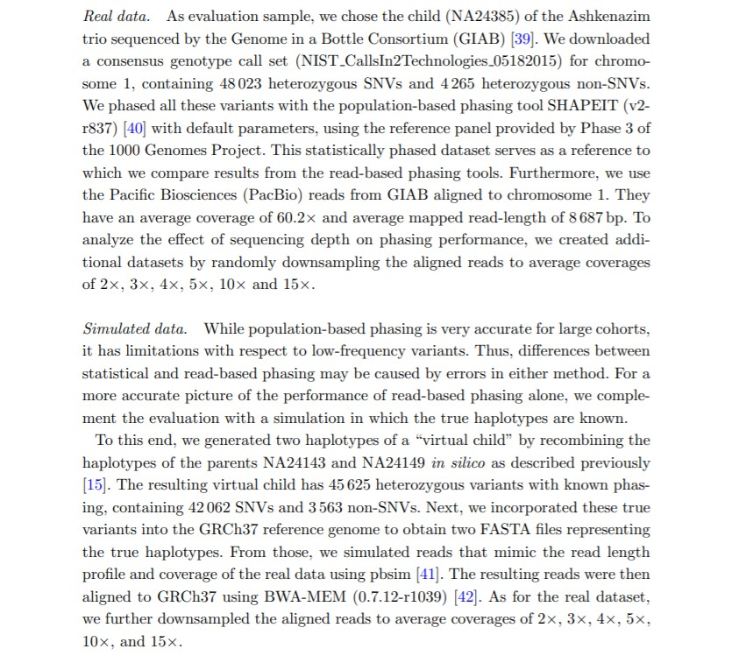
4. Check on these 3 papers to see what datasets they used and how they compare with other algorithms.
Whatshap paper used both real and simulated data: NA24143 NA24149 (NA24385 simulated)

Slide 132
May 8, 2020 Meeting @ 11AM

Slide 133
1. Check each paper/user manual how no/low coverage positions are handled
Neither Whatshap, Hapseq, or DBM papers mention how they process positions without coverage. Low coverage seems to be handled similar to high coverage positions—HapSeq2 paper used positions with 1X coverage, and assumed a fixed number of SNPs in each read.
See notes on slides 134 - 139
2. Check on these DBM and Hapseq papers to see what datasets they used and how they compare with other algorithms.
Two popular datasets 1000 Genome and HapMap seem to be used
See notes on slides 134 - 139
3. Check to see if there is any other new HA algorithms for multiple samples HA.
Slide 134 has several phasing software compared in the Whatshap paper—next I can check if these support multiple inputs
4. See papers that cited DBM, HapSeq2, Whatshap within the past 3 years to see which datasets they used.

Slide 134
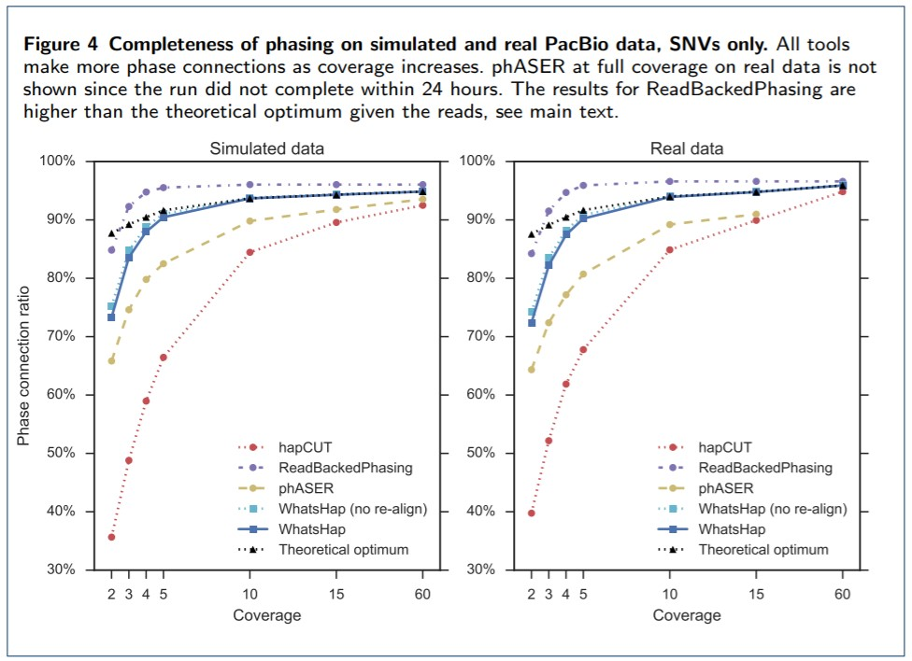
WhatsHap

Slide 136
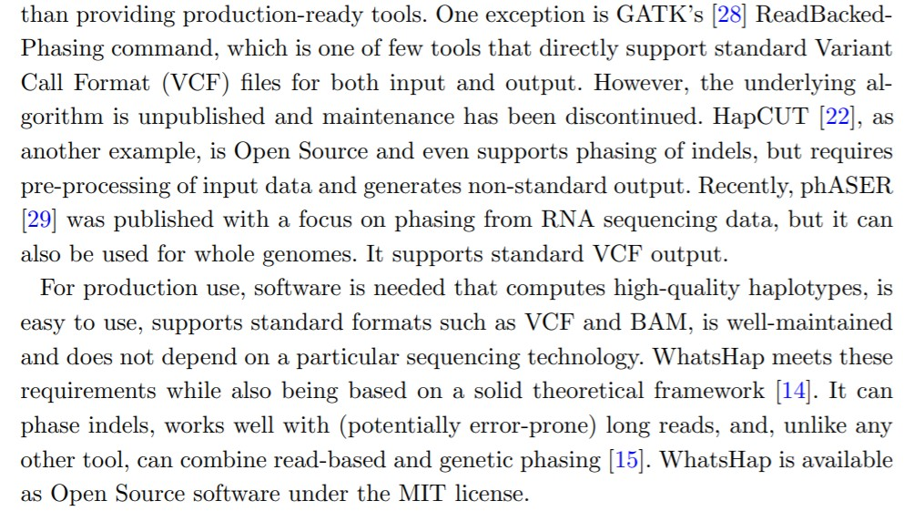
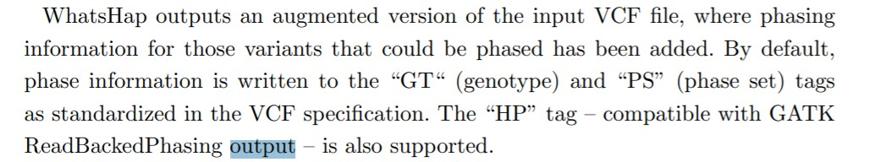

Slide 137
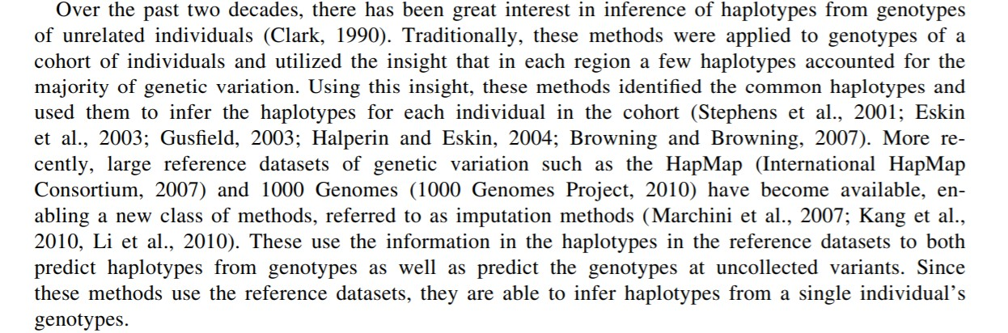
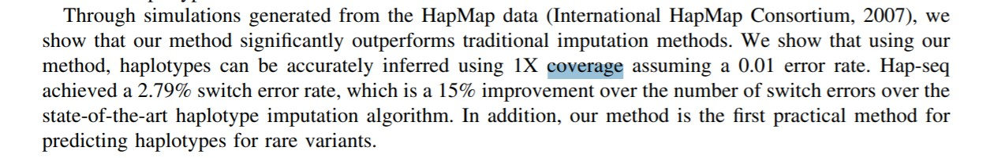
Hapseq2

Slide 138
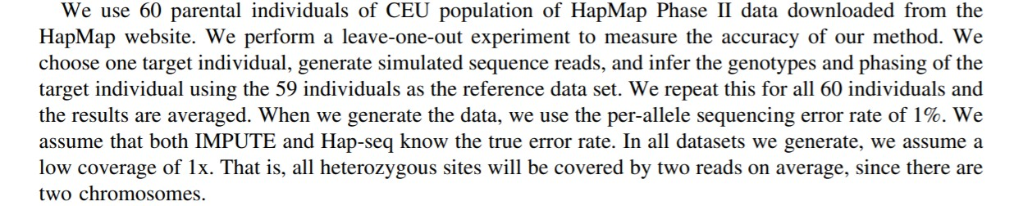
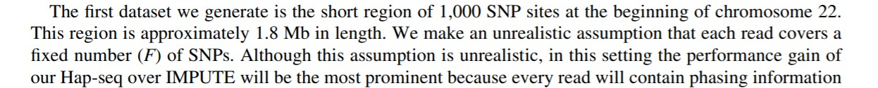

Slide 139
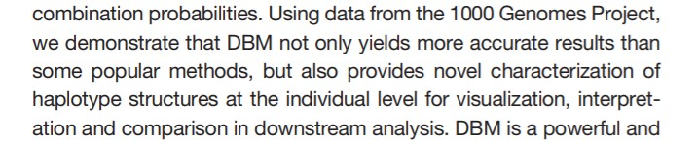
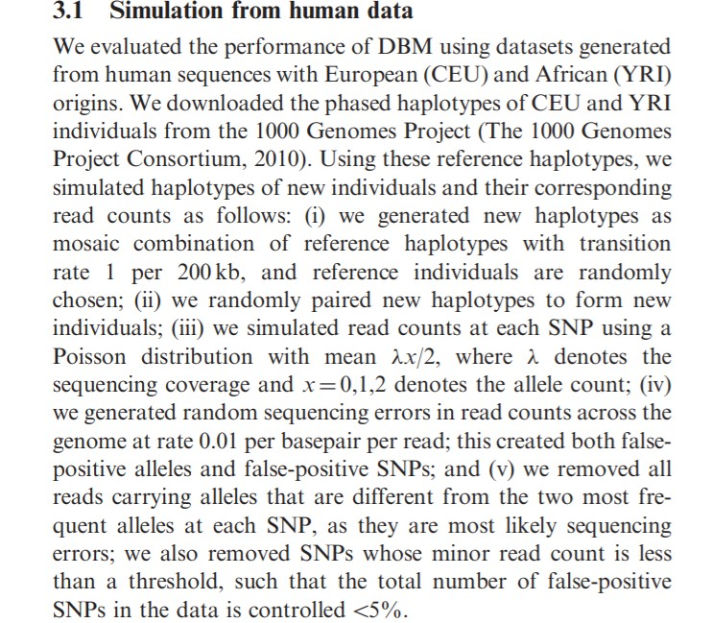
DBM

Slide 140
1. See papers that cited DBM, HapSeq2, Whatshap within the past 3 years to see which datasets they used.
2. Check if phASER, READBACKedPhaseing, hapCUT2 support multiple sample haplotype assembly.
Downloaded 3 papers
Neither mention support of multiple samples
Same for the user manual here:
3. Check if Shapeit supports multiple sample haplotype assembly.

Slide 141
May 22, 2020 Meeting @ 11AM

Slide 142
1. See papers that cited DBM, HapSeq2, Whatshap
I looked at citations--dbm: 11 hapseq: 7 Whatshap: 87
https://scholar.google.com/scholar?as_ylo=2016&hl=en&as_sdt=0,44&sciodt=0,44&cites=6855083076440370814&scipsc=
DBM - 2 of these papers are Whatshap. 9 papers may not be related to HA (2 papers on virus, 1 on strawberry haplotype capture sequencings)
https://scholar.google.com/scholar?as_ylo=2016&hl=en&as_sdt=0,44&sciodt=0,44&cites=6647035964723322392&scipsc=
https://www.nature.com/articles/ncomms4934?origin=ppub
https://www.nature.com/articles/nrg3903
https://www.sciencedirect.com/science/article/pii/S1046202315000286
https://link.springer.com/chapter/10.1007/978-3-319-07212-8_16
https://www.derekaguiar.com/resources/thesis_proposal.pdf
HapSeq2 - (1) 5 papers with "haplotype" in the title. (2) 2 citations are from Zhang's groups
(3) 1 is hap compass (4) 1 are about haplotype reference panel.
https://scholar.google.com/scholar?as_ylo=2016&hl=en&as_sdt=0,44&sciodt=0,44&cites=16530713367564057811&scipsc=
Whatshap – 87 citations including Shapeit4 and many SIHA papers

Slide 143
2. Check phaser, hapCUT2, ReadBackedPhasing to see if they support multi sample haplotype assembly
https://github.com/secastel/phaser/tree/master/phaser
https://github.com/vibansal/HapCUT2
No mention of multiple samples in phaser, hapcut2 paper or manual
https://gatk.broadinstitute.org/hc/en-us/articles/360035890411-Calling-variants-on-cohorts-of-samples-using-the-HaplotypeCaller-in-GVCF-mode
ReadBackedPhasing is a deprecated GATK tool replaced by Haplotype Caller
Haplotype Caller does support multiple samples—I will need to see if this is equivalent to multiple individuals
3. Check if Shapeit supports multi sample haplotype assembly
https://mathgen.stats.ox.ac.uk/genetics_software/shapeit/shapeit.html
No mention of multiple samples in Shapeit paper or manual

Slide 144
May 29, 2020 Meeting @ 11AM

Slide 145
1. Survey of computational haplotype determination methods for single individual
Check the samples listed in Table 3 of this paper to show where we can download the alignment files
HapMap sample NA20847 and NA12878, NA12891, NA12892
https://www.internationalgenome.org/data-portal/sample/NA20847
Sample ID can be downloaded here:
1. Search sample ID
2. Filter by alignment
3. Click download (File is typically a CRAM that is ~3GB )

Slide 146
2. Summarize HA software in excel file: date, languages, notes
See spreadsheet—a couple packages are no longer available to download
Thing of interest:
https://bmcbioinformatics.biomedcentral.com/articles/10.1186/s12859-019-3095-8
Review paper published in 2019
https://www.ncbi.nlm.nih.gov/pmc/articles/PMC5558598/
Updated paper for Haptree-X (2015)
https://github.com/jcna99/PEATH#data-sets
Peath datasets:
Fosmid dataset (Duitama et al. 2012) which has been widely used to assess and compare SIH algorithms.
Simulated dataset which was generated based on Fosmid data.
HuRef dataset (Levy et al. 2007) which has been the most widely used in SIH related articles.

Slide 147
June 12, 2020 Meeting @ 11AM

Slide 148
1. Update the phasing excel file with DBM and Haptree-X
Complete, check excel file
2. Summarize:
1. Document location of Bertie’s BAMs
2. Get SNVs in 5 samples and filter indels using Samtools
3. Extract the high coverage SNPs (628 positions >= 20 coverage)
4. Prepare Whatshap input and phase haplotypes
5 samples were phased using Whatshap and 628 positions created
5. Prepare HapSeq2 input and phase haplotypes
6. Prepare DBM input and phase haplotypes
7. Compare haplotypes and generate same results as table
8. Generate 120 positions and repeat above steps

Slide 149
3. Search for aligned data for the following samples
NA18506, NA18507, NA20847, HG01377, NA19240, NA20431
https://www.internationalgenome.org/data-portal/sample/NA18506
Father NA18507 Mother NA18508 (whole genome)
https://www.internationalgenome.org/data-portal/sample/NA18507
Child NA18506
https://www.internationalgenome.org/data-portal/sample/NA20847
https://www.internationalgenome.org/data-portal/sample/HG01377
https://www.internationalgenome.org/data-portal/sample/NA19240
Mother NA19238 Father NA19239
https://www.coriell.org/0/Sections/Search/Sample_Detail.aspx?Ref=NA20431&product=DNA
for sale

Slide 150
June 19, 2020 Meeting @ 11AM

Slide 151
1.1 Prepare HapSeq2 input and phase haplotypes
1.2 Prepare DBM input and phase haplotypes
628 positions phased with each package. I am now comparing the results.
1.3 Compare haplotypes in order to generate results in poster table
1.4 Compare results with table (slide 128)
1.5 Generate 120 positions and repeat above steps (slide 106)
2. Record the runtime of some preparing steps for Whatshap, Hapseq2, DBM
3. Record the runtime of Whatshap, Hapseq2, DBM

Slide 152
June 26, 2020 Meeting @ 11AM

Slide 153
1.1 Extract genotypes and haplotypes from Whatshap results
1.2 Extract genotypes and haplotypes from Hapseq2 results
1.3 Extract genotypes and haplotypes from DBM results
Finding: Whatshap input required the least effort to prepare, but the VCF output needed to processed to extract alleles
Vice versa, DBM output made it simple to get the alleles, but DBM input required many steps to prepare
1.4 Pairwise comparison of 628 genotypes using Perl
1.5 Pairwise comparison of 628 Haplotypes using R
1.6 Verify new results are the same as the table (slide 128)
2. Extract the 5pick3 positions (120) from 5 samples and repeat steps

Slide 154
July 3, 2020 Meeting @ 11AM

Slide 155
1.1 Pairwise comparison of 628 genotypes using Perl
1.2 Pairwise comparison of 628 Haplotypes using R
1.3 Compare pairwise agreement results with the original table (slide 128)
See pairwise agreement results on slide 156. Slide 157 is a copy of slide 126. DBMs agreement with each package improved by about 100 positions. This may be a result of better understanding each package over the past 4 months. I phased each package using the same VCF this week. In April each package phased a different VCF.
2. Extract the 120 positions from 5 samples and repeat the above steps (slide 106)
3. Summarize the steps preparing input and output for each package

Slide 156
1.1 Pairwise comparison of 628 genotypes using Perl
1.2 Pairwise comparison of 628 Haplotypes using R
1.3 Compare pairwise agreement results with the original table (slide 128)
See pairwise agreement results on slide 156. Slide 157 is a copy of slide 126. DBMs agreement with each package improved by about 100 positions. This may be a result of better understanding each package over the past 4 months. I phased each package using the same VCF this week. In April each package phased a different VCF.
2. Extract the 120 positions from 5 samples and repeat the above steps (slide 106)
3. Summarize the steps preparing input and output for each package

Slide 157
DBM and WhatsHAP Pairwise Comparison
Agreement | 826 | 827 | 832 | 847 | 850
Strict | 379 | 374 | 414 | 385 | 413
Non-strict | 465.5 | 463.5 | 486.5 | 477 | 484.5
haplotype | 391.5 | 409 | 420 | 407.5 | 417.5
HapSeq2 and WhatsHAP Pairwise Comparison
Agreement | 826 | 827 | 832 | 847 | 850
Strict | 557 | 574 | 578 | 582 | 574
Non-strict | 591.5 | 601 | 603 | 604 | 601
haplotype | 468 | 490 | 492 | 469.5 | 501.5
HapSeq2 and DBM Pairwise Comparison
Agreement | 826 | 827 | 832 | 847 | 850
Strict | 383 | 381 | 410 | 391 | 407
Non-strict | 471 | 467.5 | 486.5 | 479 | 482.5
haplotype | 444 | 451.5 | 462.5 | 451 | 454.5
628 total positions - phased >= 20 coverage
Script: PhasingWhatshapHapseqDBM.2020.July.1.txt
Input folder: /home/s_m774/data/new.MIHA/

Slide 158
DBM and WhatsHAP Pairwise Comparison
Agreement | 826 | 827 | 832 | 847 | 850
Strict | 246 | 270 | 282 | 272 | 287
Non-strict | 354.5 | 374 | 382.5 | 374 | 379.5
haplotype | 285 (330.5) | 320.5 (357) | 317 (352.5) | 292.5 (342) | 318 (347.5)
HapSeq2 and WhatsHAP Pairwise Comparison
Agreement | 826 | 827 | 832 | 847 | 850
Strict | 560 | 575 | 577 | 572 | 572
Non-strict | 594 | 601.5 | 602 | 599 | 600
haplotype | 475 (520) | 501.5 (541.5) | 500 (532) | 470.5 (521) | (501) (532)
HapSeq2 and DBM Pairwise Comparison
Agreement | 826 | 827 | 832 | 847 | 850
Strict | 254 | 261 | 285 | 282 | 285
Non-strict | 358.5 | 366.5 | 383.5 | 377 | 380.5
haplotype | 335.5 | 347.5 | 353.5 | 347 | 348.5
628 total positions – Whatshap phased >= 20 coverage
Script file: MIHA.2020.4.10 Input folder: /home/s_m774/data/miha/
“red” number for haplotype comparison with NO “-”, which is incorrect,
the “green” one is the correct with the “-” for whatshap unphased positions.

Slide 159
July 3 Meeting Notes
Compared the April-2020 run with the July-2020 run to see why the results are different
(1) The old and new 628 positions are identical:
diff /home/s_m774/data/new.MIHA.June2020/bcftools/results/July2Meeting.July1.positions.txt /home/s_m774/data/miha/whatshap.2020.mar27/July2Meeting.Mar20.positions.txt
(2) The April 2020 run of DBM and HapSeq2 run on a VCF with 13557 SNVs (i.e., all SNVs, with many of them are low coverage), but the July, 2020 run of all 3 MIHA algorithm, it is based on the VCF of 628 positions, so they are doing haplotype for different size of SNVs.
Sherwin found that for the 3 MIHA comparison results obtained on July 3, 2020 (PPT slide page 156) is very different from the 3 MIHA comparison results obtained on April 24, 2020 (PPT slides 126 and 157, which are identical). It shows that the DBM performance or agreement with other two algorithms are improved more. This is likely due to the following reasons:
(1) The VCF file for DBM and HapSeq2 are different between the April-2020 and July-2020 runs
(2) For the April-2020 run of DBM and HapSeq2, there are 5 VCF files for 5 samples; for the July-2020 run of DBM and HapSeq2, the ONE VCF file used for whatshap is used. That is, the VCF files for the April-2020 and July-2020 are different.
Shewin’s explained “I phased each package using the same VCF July, 2020, In April , 2020; each package phased a different VCF”
How to manipulate the VCF to get the 628 positions, For the July 2020 run, Sherwin issued
./bcftools view -i 'DP>=20’ but the April 2020, he used "grep“
This did not cause a problem.

Slide 160
Continued
[s_s355@login1 ~]$ head /home/s_m774/data/miha/dbm.2020.mar20/chr10.5sample.counts
I SID I1 I1 I2 I2 I3 I3 I4 I4 I5 I5
M 1 0 0 0 0 0 0 0 0 0 2
M 2 0 0 0 0 0 0 0 0 0 2
M 3 0 0 0 0 0 1 0 0 0 3
M 4 7 0 1 0 7 0 1 4 5 2
M 5 5 0 1 0 10 0 3 4 2 2
M 6 5 0 1 0 10 0 3 4 3 2
M 7 0 0 0 0 0 4 0 0 1 0
M 8 0 0 0 0 0 0 0 0 0 4
M 9 0 1 0 0 0 0 0 0 0 0
[s_s355@login1 ~]$ head /home/s_m774/data/new.MIHA.June2020/dbm/chr10.5sample.counts
I SID I1 I1 I2 I2 I3 I3 I4 I4 I5 I5
M 1 7 0 1 0 7 0 1 4 5 2
M 2 5 0 1 0 10 0 3 4 2 2
M 3 5 0 1 0 10 0 3 4 3 2
M 4 7 1 5 0 0 19 8 0 14 6
M 5 17 2 12 0 29 0 8 0 27 0
M 6 18 0 11 0 25 0 23 2 23 0
M 7 9 2 10 0 39 0 6 0 21 0
M 8 37 18 59 3 1 116 40 0 50 62
M 9 7 1 13 0 0 18 2 0 8 5

Slide 161
July 11, 2020 Meeting @ 10AM

Slide 162
1. Add meeting notes from July 3 to slides - Complete
2.1 Call SNVs for 5 samples
2.2 Phase using Whatshap
2.3 Extract the 120 positons (pick 3) from Whatshap haplotypes
5 samples phased using Whatshap and got haplotypes at 120 positions
2.4 Prepare HapSeq2 input and phase haplotypes
2.5 Prepare DBM input and phase haplotypes
2.6 Phase and compare pairwise agreements of haplotypes (slide 106)
3. Summarize the steps preparing input and output for each package

Slide 163
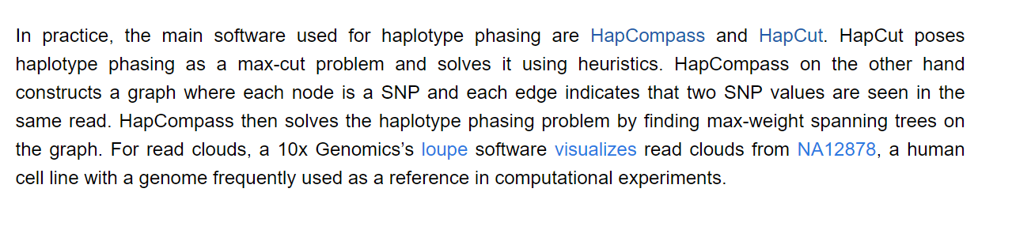
More findings
This Stanford lecture states HapCut and HapCompass are used in practice
https://data-science-sequencing.github.io/Win2018/lectures/lecture10/
Review Paper in 2018 (42 citations) Comparison of phasing strategies for whole human genomes.
Review Paper for many algorithms (2005) A Comprehensive Literature Review of Haplotyping Software.

Slide 164
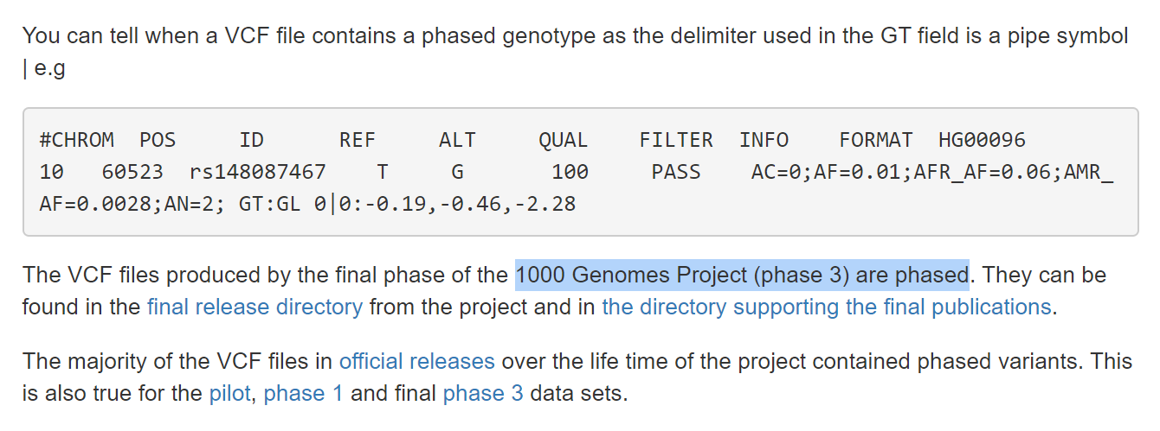
More findings
https://www.internationalgenome.org/faq/are-1000-genomes-variant-calls-phased/

Slide 165
Notes on phased NA12878 data (see slide p164)
NA12878 Chr10 phased data by shapeit2
https://www.internationalgenome.org/data-portal/sample/NA12878
What does "integrated variant call" mean? Does it mean they integrate with the parents sequencing data? Does it mean they integrate NA12878 sequencing runs that are conducted by different institutes and/or different sequencing technologies?
Answer: https://www.internationalgenome.org/announcements/Variant-calls-from-1000-Genomes-Project-data-calling-against-GRCh38
Variant calls from 1000 Genomes Project data calling against GRCh38
An integrated and phased biallelic SNV call set, generated from alignments of the 1000 Genomes phase three low coverage and exome sequence data, is available on our FTP site. These calls were called directly against GRCh38. This data set combines call sets generated using GATK, FreeBayes and BCFtools, with subsequent imputation and phasing carried out using Beagle and SHAPEIT2. A recent poster describing the methods used in generating this data is available and a data note is in preparation. We are also in the process of submitting the data to EVA/dbSNP.
The files include per chromosome files with genotypes for all samples, a genome wide sites file and genotype files for each of the supporting call sets. The main files contain only unrelated individuals, with details for related individuals available in a separate set of files.
Data files are available at: http://ftp.1000genomes.ebi.ac.uk/vol1/ftp/data_collections/1000_genomes_project/release/20181203_biallelic_SNV/

Slide 166
July 18, 2020 Meeting @ 4PM

Slide 167
1. Add July 11 meeting notes to slide 165
Complete see slide 165
For 120 positions:
2.1 Find the old scripts and upload to Canvas
2.2 Phase Whatshap and extract 120 positions
2.3 Phase Hapseq2 and extract 120 positions
2.4 Phase DBM and extract 120 positions
2.5 Compare pairwise agreement of haplotypes with slide 106
Complete, see slide 168. Slide 169 is a copy of slide 106.
Significant improvement in agreements in genotype and haplotype with dbm
3. Create Perl code to extract “1/0” or “0/1” positions from VCF with minimum threshold.

Slide 168
DBM and WhatsHAP Pairwise Comparison
Agreement | 826 | 827 | 832 | 847 | 850
Strict | 95 | 96 | 101 | 94 | 100
Non-strict | 106 | 104 | 108.5 | 105.5 | 109.5
haplotype | 82.5 | 89.5 | 81.5 | 85 | 86.5
HapSeq2 and WhatsHAP Pairwise Comparison
Agreement | 826 | 827 | 832 | 847 | 850
Strict | 111 | 107 | 116 | 110 | 113
Non-strict | 115.5 | 113.5 | 118 | 115 | 116.5
haplotype | 87.5 | 96 | 84.5 | 89 | 91.5
HapSeq2 and DBM Pairwise Comparison
Agreement | 826 | 827 | 832 | 847 | 850
Strict | 92 | 92 | 97 | 92 | 96
Non-strict | 104.5 | 101.5 | 106.5 | 104.5 | 108
haplotype | 94.5 | 94.5 | 90.5 | 94.5 | 96
120 total positions
Script: Pick3PhasingWhatshapHapseqDBM.2020.July.10.txt

Slide 169
This is a copy of slide 106 (Wrong input 847,850)
DBM and WhatsHAP Pairwise Comparison
Agreement | 826 | 827 | 832 | 847 | 850
Strict | 50 | 48 | 60 | 46 | 60
Non-strict | 83.5 | 81 | 88.5 | 79 | 86
haplotype | 59.5 | 63.5 | 61.5 | 58 | 65.5
HapSeq2 and WhatsHAP Pairwise Comparison
Agreement | 826 | 827 | 832 | 847 | 850
Strict | 109 | 110 | 116 | 110 | 113
Non-strict | 114.5 | 114.5 | 118 | 115 | 116.5
haplotype | 87 | 94.5 | 87.5 | 89.5 | 90
ASHG: HapSeq2 and DBM Pairwise Comparison
Agreement | 826 | 827 | 832 | 847 | 850
Strict | 49 | 48 | 60 | 45 | 62
Non-strict | 83.5 | 81.5 | 88.5 | 78 | 87.5
haplotype | 76.5 | 71.5 | 75.5 | 70 | 76.5

Slide 170
July 25, 2020 Meeting @ 4PM

Slide 171
1. Upload the old scripts used to phase haplotypes in slide 106 and slide 126 to Canvas - Complete, uploaded as 53.18.July.2020-1.zip
The script used to phase 120 positions (DBM) are as far back as September 2019
2. Get the allele counts for 120 positions phased by DBM in September 2019:
/home/s_m774/data/dbm/pair.2depth.5sample/5sampleDBM.9.28/sample.counts
3. Compare the above file to DBMs input in July 2020:
4. Create Perl code to extract positions from VCF by counting heterozygous samples (0/1 or 1/0) with minimum threshold. Use this script check how many positions have >=2 and >=3 samples
Q: Why do we want heterozygous positions?
Only heterozygous positions are inferred to haplotype.

Slide 172
July 25 Meeting notes:
(1) We checked if whatshap infers haplotype blocks when we do haplotype assembly for multiple individuals? The answer is yes, see /home/s_m774/data/new.MIHA.June2020/whatshap/results/Whatshap.phased.5sample.vcf
(2) DBM and Hapseq2 output do not have the phase identifier or haplotype block IDs.
(3) Our haplotype block definition discussion, see "July25.2010.Hap.Block.Defintion.docx“

Slide 173
August 8, 2020 Meeting @ 10AM

Slide 174
1. Upload each old script used to phase haplotypes in slide 106 to Canvas:
See the included folder-DBM haplotype results are used in October 2019 script. DBM phasing was not scripted after a comprehensive search.
2. Compare DBMs input in the old and new script:
2019-9: /home/s_m774/data/dbm/pair.2depth.5sample/5sampleDBM.9.28/sample.counts
2020-6: /home/s_m774/data/new.MIHA.June2020/dbm/chr10.5sample.counts
See slide 175
3. Create Perl code to extract positions from VCF by counting heterozygous samples (0/1 or 1/0) with minimum threshold. Use this script check how many positions have >=2 and >=3 samples

Slide 175
wc -l /home/s_m774/data/dbm/pair.2depth.5sample/5sampleDBM.9.28/sample.counts
3125
wc -l /home/s_m774/data/new.MIHA.June2020/dbm/chr10.5sample.counts
629
DBM’s input files sample.snps and sample.counts should have the same positions. The September 2019 run was prepared incorrectly.
wc –l /home/s_m774/data/dbm/pair.2depth.5sample/5sampleDBM.9.28/
3125 sample.counts
121 sample.g
120 sample.snps

Slide 176
# 120 SNV: Old run of DBM (with on script available any more) -- slide 106
/home/s_m774/data/dbm/pair.2depth.5sample/5sampleDBM.9.28
# New run of DBM (with scripts available)
/home/s_m774/data/july2020.MIHA/dbm
628 SNV: /home/s_m774/data/july2020.MIHA/dbm
# NEW run (June 2020) 628 SNV DBM
/home/s_m774/data/new.MIHA.June2020/dbm
# This run is done by first filtering out those 628 SNVs, and then do the phasing
Old 628 directory: /home/s_m774/data/miha/
/home/s_m774/data/miha/dbm.2020.mar20
# The DBM is done on the whole datasets with ALL SNVs and then extract the 628 positions.
1. For the Sept 28, 2019 run of DBM, no scripts or detailed record can be found, the most relevant one is
"August13.2019.PairEndDBM.txt" and it is incorrect.
2. In addition, we found the two DBM input files "sample.counts" and "sample.snps" do have same number of SNVs,
as shown below: For the old Sept 28, 2019, these two file show different number of SNVs.
But in the July2020 run, they have the same 120 SNVs.

Slide 177
# Old run of DBM (with on script available any more) -- slide 106
/home/s_m774/data/dbm/pair.2depth.5sample/5sampleDBM.9.28
# New run of DBM (with scripts available)
/home/s_m774/data/july2020.MIHA/dbm
/home/s_m774/data/dbm/pair.2depth.5sample/5sampleDBM.9.28
wc -l *
wc: counts: Is a directory
0 counts
3125 sample.counts
121 sample.g
10 sample.pop
120 sample.popr
500 sample.pops
120 sample.snps
3996 total

Slide 178
/home/s_m774/data/july2020.MIHA/dbm
(base) [s_s355@login1 dbm]$ wc -l *
14044 5sample.chr10.vcf
120 chr10.5sample.counts
121 chr10.5sample.g
10 chr10.5sample.pop
120 chr10.5sample.popr
500 chr10.5sample.pops
120 chr10.5sample.snps
120 chr10.826.count
120 chr10.827.count
120 chr10.832.count
120 chr10.847.count
120 chr10.850.count

Slide 179
/home/s_m774/data/new.MIHA.June2020/dbm
/home/s_m774/data/july2020.MIHA/dbm
# NEW run (June 2020) 628 SNV DBM
/home/s_m774/data/new.MIHA.June2020/dbm
# This run is done by first filtering out those 628 SNVs, and then do the phasing
Old 628 directory: /home/s_m774/data/miha/
/home/s_m774/data/miha/dbm.2020.mar20
# The DBM is done on the whole datasets with ALL SNVs and then extract the 628 positions.
/home/s_m774/data/new.MIHA.June2020/dbm
wc -l *
1117 5sample.chr10.vcf
629 chr10.5sample.counts
629 chr10.5sample.g
10 chr10.5sample.pop
628 chr10.5sample.popr
500 chr10.5sample.pops
628 chr10.5sample.snps
628 chr10.826.count
628 chr10.827.count
628 chr10.832.count
628 chr10.847.count
628 chr10.850.count

Slide 180
/home/s_m774/data/miha/dbm.2020.mar20
(base) [s_s355@login1 dbm.2020.mar20]$ wc -l *
14044 alleleDepth.5sample.chr10.vcf
13558 chr10.5sample.counts
13558 chr10.5sample.g
10 chr10.5sample.pop
13557 chr10.5sample.popr
500 chr10.5sample.pops
13557 chr10.5sample.snps
13557 chr10.826.count
13557 chr10.827.count
13557 chr10.832.count
13557 chr10.847.count
13557 chr10.850.count
2049 dbm

Slide 181
August 12, 2020 Meeting @ 3PM

Slide 182
0. Add meeting notes to slide 176
Complete
1. Start manuscript with Comparative Analysis.
Rough draft complete and sent via Outlook
2. Start looking into 1000 genome data.

Slide 183
August 21, 2020 Meeting @ 10AM

Slide 184
1. Add title/description to each table
Complete, see each table in summary
2. Add paper references (Get APA from google scholar)
Complete, see reference page
3. Reference each figure used within the text
Complete, see MIHA.summary.Aug20.2020
4. Update Comparative Analysis with Dr. Sun suggestions
Complete, see MIHA.summary.Aug20.2020

Slide 185
August 28, 2020 Meeting @ 11AM

Slide 186
1. Create an introduction/background
Complete, see introduction and background
2. Update Comparative Analysis with Dr. Sun suggestions
Complete, see comparative analysis
3. Search for other datasets
Complete, located samples used on table 3 in the paper “Survey of computational haplotype determination methods for single individual” by Je-Keun Rhee. See slide 187.

Slide 187
Samples NA18506, NA18507, NA20847, HG01377, NA19240, NA20431
https://www.internationalgenome.org/data-portal/sample/NA12878
https://www.internationalgenome.org/data-portal/sample/NA18506
Father NA18507 Mother NA18508 (whole genome)
https://www.internationalgenome.org/data-portal/sample/NA18507
Child NA18506
https://www.internationalgenome.org/data-portal/sample/NA20847
https://www.internationalgenome.org/data-portal/sample/HG01377
https://www.internationalgenome.org/data-portal/sample/NA19240
Mother NA19238 Father NA19239
https://www.coriell.org/0/Sections/Search/Sample_Detail.aspx?Ref=NA20431&product=DNA
for sale

Slide 188
September 4, 2020 Meeting @ 11AM

Slide 189
1.1 Add a summary of each HA algorithm to introduction
1.2 Revise introduction using Dr. Sun notes
2. Add trios to the excel file-preferably within a single population

Slide 190
September 11, 2020 Meeting @ noon

Slide 191
1. Revise introduction using Dr. Sun notes
Complete, see the introduction.
2. Download a 1000 genome sample to LEAP server (Can use wget, samtools view)
https://www.internationalgenome.org/faq/how-do-i-get-sub-section-bam-file/
I use wget to download NA12878 in the background which is 15.7GB. Currently downloading in this folder: /home/s_m774/1000GenomeData
Using “samtools view” directly on an ftp address warns to index the cram first.
3. Find more trios with European Ancestry
I added 9 more samples to the Sample Summary. Summary now has 27 samples with 9 trio sets.

Slide 192
September 19, 2020 Meeting @ 6pm

Slide 193
Download IGSR samples to LEAP server and create bam.
NA12878 bam alignments on IGSR are ONLY made using exome reads. Are exome reads acceptable?
NA12878 called variants in vcf are available on IGSR—these can be used for our purpose. Is Multi-Sample Variant Calling preferred to combining single sample variants for MIHA?
Paper on Multi-Sample Variant Calling:
https://www.ncbi.nlm.nih.gov/pmc/articles/PMC4496949/
Update: IGSR called variants seem to include haplotypes from Shapeit.
Mpileup does not support calling variants using cram files—need to convert to bam prior to calling variants.
Cram format always requires an accompanying reference. Converting a cram to bam using samtools requires a fasta reference. Samtools documentation is included on next slide.
I am working on creating bam files using samtools view—error shown on slide 195.

Slide 194
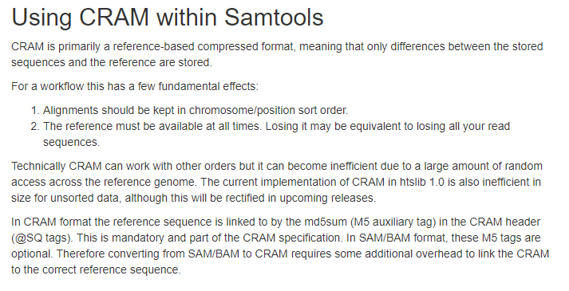
Samtools documentation
http://www.htslib.org/workflow/#mapping_to_cram

Slide 195
Samtools view usage
-o output -b bam -T reference genome -h header (default is headerless sam)
/group/hon/hon3398o/0.course.files/software/samtools-1.9/samtools view -b -T hg38.fa -o hg38.NA12878.bam NA12878.final.cram
[samfaipath] build FASTA index...
[E::cram_decode_slice] MD5 checksum reference mismatch for ref 0 pos 248747869..248786716
[E::cram_decode_slice] CRAM: 720250455f7998c0d906314e9aae3434
[E::cram_decode_slice] Ref : 5e868f1c3be1506207b2097a2371c4c5
[E::cram_next_slice] Failure to decode slice
[main_samview] truncated file.
# Biostars solution may be to --enable lib curl option
https://www.biostars.org/p/389132/

Slide 196
September 26, 2020 Meeting @ 6pm

Slide 197
1. Create perl code to calculate switch error
pwd
/home/s_m774/data/july2020.MIHA/compare
2. Get switch error rate using each package as reference

